Slide 1
Machine Reading, Question Answering & Dialog AMMI – Deep NLP – Part III
Angela Fan, Louis Martin, Antoine Bordes
Facebook AI Research (Paris)
March 18-22, 2019

Slide 2
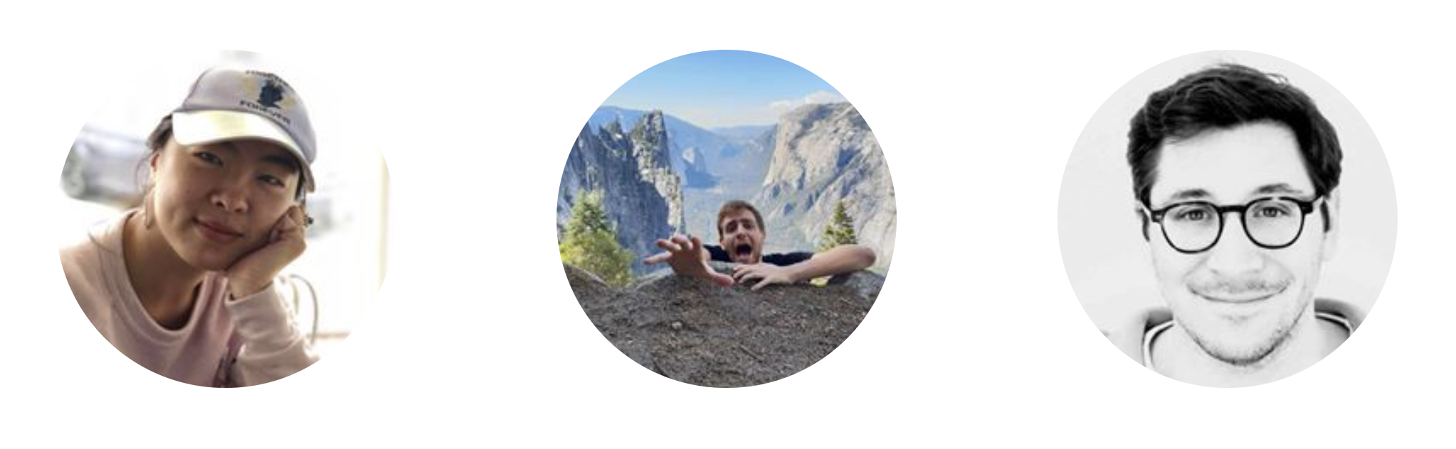
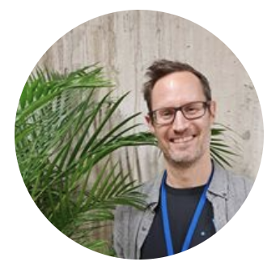
Who are we?
Angela angelafan@fb.com
PhD Student FAIR Paris
Louis
louismartin@fb.com
PhD Student FAIR Paris
Antoine
abordes@fb.com
Director FAIR Paris
+ Help from Sebastian Riedel (Research Scientist FAIR London)

Slide 3
This Class:
Machine Reading with deep learning
Open-domain Question answering
Deep learning for dialogue

Slide 4
Quick schedule
Monday: 2pm lecture “Machine Reading” [Antoine]
Tuesday: 9am labs “Machine Reading” [Angela/Louis] + office hours 11m [All]
Wednesday: 2pm lecture “Question Answering” [Antoine] + office hours 4pm [All]
Thursday: 9am lecture “Dialog” [Antoine] + 11:15am exam [All]
Friday: 2pm labs “Dialog” [Angela/louis]

Slide 5
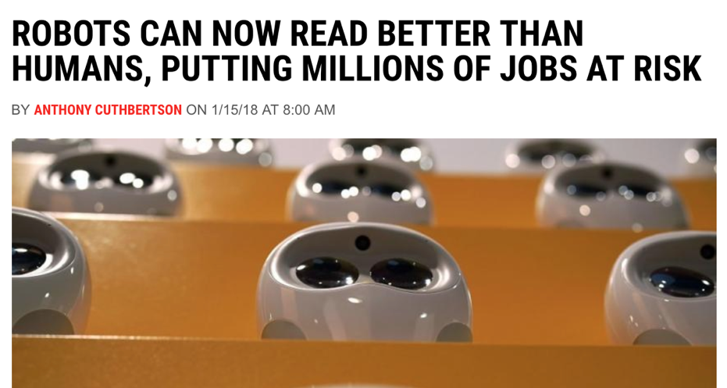
Machine Reading
Notes:
What could this mean?
What should this mean?

Slide 6
Machine Reading
ROBOTS CAN NOW PATTERN MATCH ON A BENCHMARK DATASET BETTER THAN HUMANS
Notes:
What could this mean?
What should this mean?

Slide 7
Machine Reading
BUT THERE HAS BEEN A LOT OF PROGRESS AND MACHINE READING RESEARCH ACTIVITY HAS SKYROCKETED
Notes:
But there has been a lot of process and activity in this area has sky rocketed

Slide 8
Main (big) motivation
Machines processing text to satisfy an information need is long standing goal of AI

Slide 9
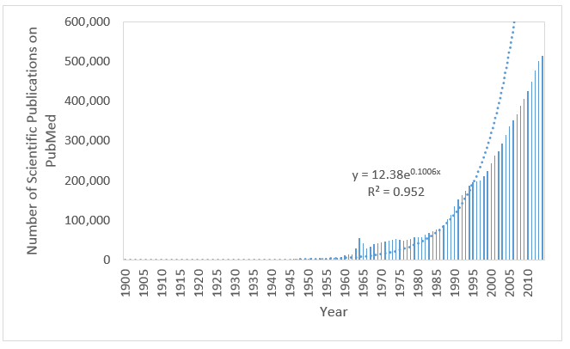


Motivation 1: Information Overload
[Information Need]
uses for

Slide 10
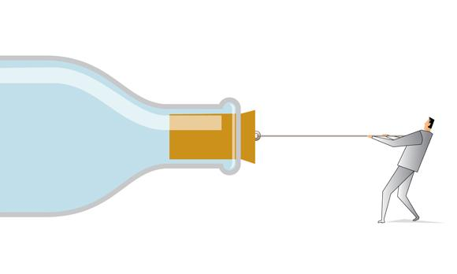
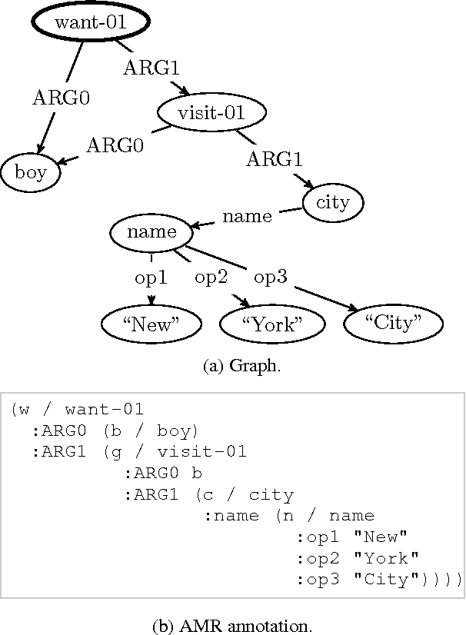
Motivation 2: The Knowledge Acquisition Bottleneck
“The problem of knowledge acquisition is the critical bottleneck problem in artificial intelligence.” E. A. Feigenbaum 1984
[Knowledge]
[Meaning]
[Information Need]
uses for

Slide 11
Applications: Question Answering
In January 1880, two of Tesla's uncles put together enough money to help him leave Gospić for Prague where he was to study. Unfortunately, he arrived too late to enrol at Charles-Ferdinand University; he never studied Greek, a required subject; and he was illiterate in Czech, another required subject. Tesla did, however, attend lectures at the university, although, as an auditor, he did not receive grades for the courses.
What city did Tesla move to in 1880?
?
Prague
[Text]
[Meaning]
[Information Need]

Slide 12
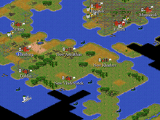
Applications: Helping Agents to learn Faster
Branavan et al., JMLR’12
The natural resources available where a population settles affects its ability to produce food and goods. Build your city on a plains or grassland square with a river running through it if possible.
?
[Text]
[Meaning]
[Information Need]

Slide 13
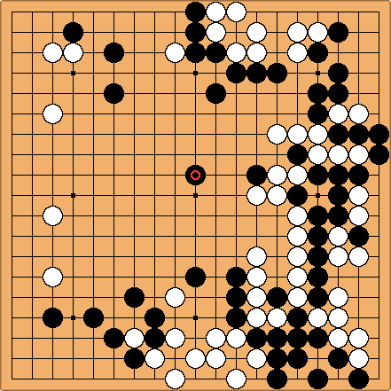
Applications: Helping Agents to learn Faster
A fundamental Go strategy involves keeping stones connected. Connecting a group with one eye to another one-eyed group makes them live together. Connecting individual stones into a single group results in an increase of liberties ...
?
[Text]
[Meaning]
[Information Need]

Slide 14
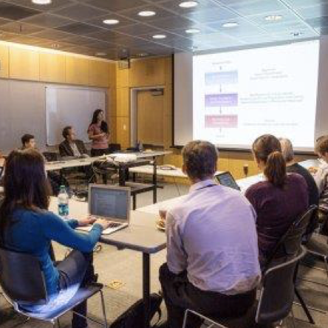
Applications: Support a Molecular Tumor Board
Poon et al., ACL’17
The deletion mutation on exon-19 of EGFR gene was present in 16
patients, while the L858E point mutation on exon-21 was noted in 10.
All patients were treated with gefitinib and showed a partial response.
?
?
drug-drug?
[Text]
[Meaning]
[Information Need]

Slide 15
Machine Reading
Machines understanding text?

Slide 16
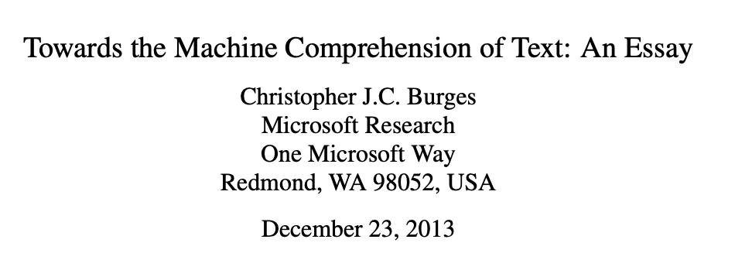
Machine Reading
“A machine comprehends a passage of text if, for any question regarding that text that can be answered correctly by a majority of native speakers, that machine can provide a string which those speakers would agree both answers that question, and does not contain information irrelevant to that question.”
Notes:
Connect machine reading with human comprehension

Slide 17
Machine Reading
A machine processes a passage of text to satisfy an information need (usually answer a question on it)

Slide 18
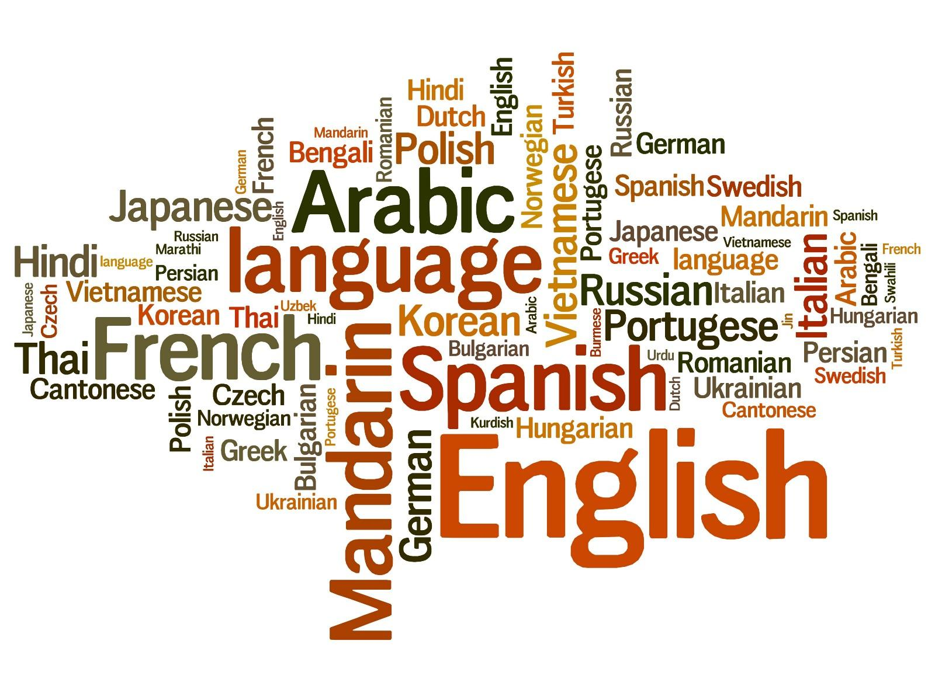
Machine Reading
In January 1880, two of Tesla's uncles put together enough money to help him leave Gospić for Prague where he was to study. Unfortunately, he arrived too late to enrol at Charles-Ferdinand University; he never studied Greek, a required subject; and he was illiterate in Czech, another required subject. Tesla did, however, attend lectures at the university, although, as an auditor, he did not receive grades for the courses.
[Passage of Text]
[Information Need]
uses for

Slide 19
Machine Reading
In January 1880, two of Tesla's uncles put together enough money to help him leave Gospić for Prague where he was to study. Unfortunately, he arrived too late to enrol at Charles-Ferdinand University; he never studied Greek, a required subject; and he was illiterate in Czech, another required subject. Tesla did, however, attend lectures at the university, although, as an auditor, he did not receive grades for the courses.
?
[Passage of Text]
[Meaning]
[Information Need]
converts into
uses for

Slide 20
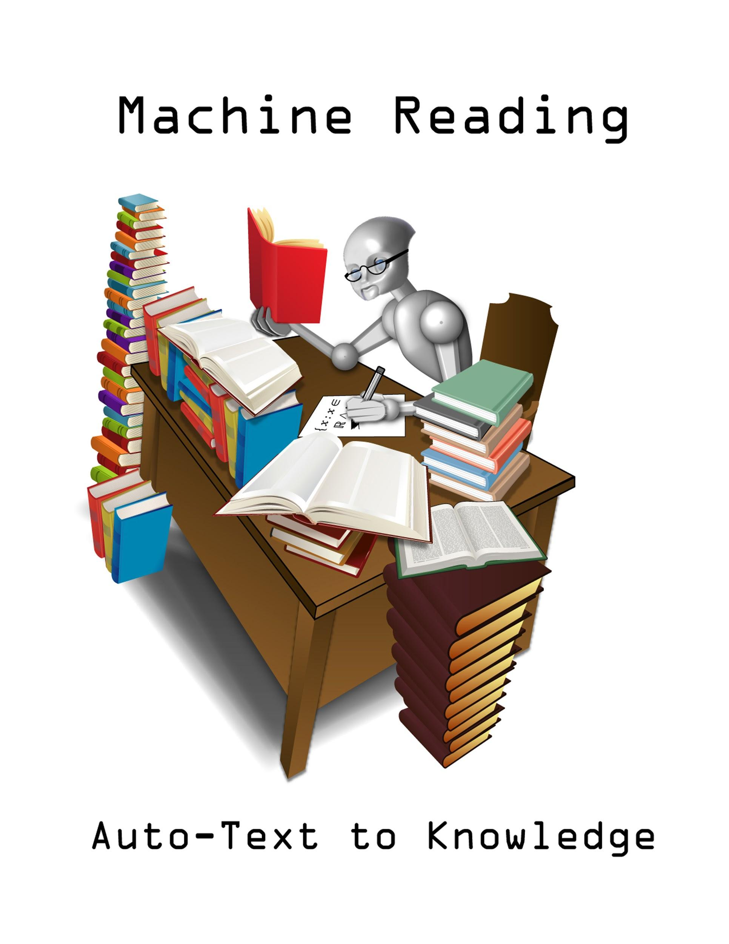
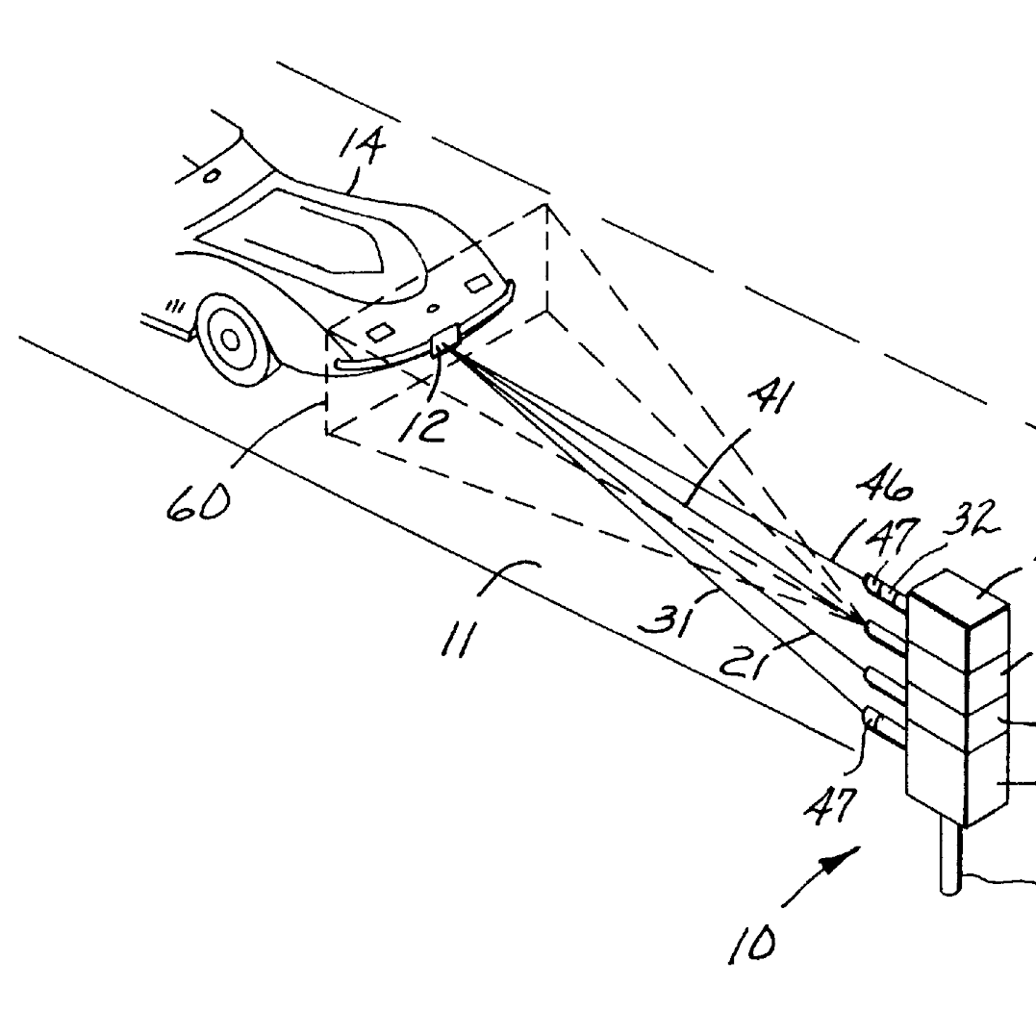
Timeline of Machine Reading
Something else entirely!
Text to Meaning Representations
End-to-End Machine Reading
?
?
?
before 2006
2006-2014
since 2014
Etzioni et. all, DARPA etc.

Slide 21
Today we cover:
?
End-to-End Machine Reading
?
since 2014

Slide 22
Machine Reading
In January 1880, two of Tesla's uncles put together enough money to help him leave Gospić for Prague where he was to study. Unfortunately, he arrived too late to enrol at Charles-Ferdinand University; he never studied Greek, a required subject; and he was illiterate in Czech, another required subject. Tesla did, however, attend lectures at the university, although, as an auditor, he did not receive grades for the courses.
?
[Passage of Text]
[Meaning]
[Information Need]
converts into
uses for

Slide 23
Symbolic Approaches (until 2014 or so)
In January 1880, two of Tesla's uncles put together enough money to help him leave Gospić for Prague where he was to study. Unfortunately, he arrived too late to enrol at Charles-Ferdinand University; he never studied Greek, a required subject; and he was illiterate in Czech, another required subject. Tesla did, however, attend lectures at the university, although, as an auditor, he did not receive grades for the courses.
?
[Passage of Text]
[Meaning]
[Information Need]
converts into
uses for

Slide 24
End-to-End Approaches (since 2014 or so)
In January 1880, two of Tesla's uncles put together enough money to help him leave Gospić for Prague where he was to study. Unfortunately, he arrived too late to enrol at Charles-Ferdinand University; he never studied Greek, a required subject; and he was illiterate in Czech, another required subject. Tesla did, however, attend lectures at the university, although, as an auditor, he did not receive grades for the courses.
[Passage of Text]
[Meaning]
[Information Need]

Slide 25
What do we need from a representation?
Fast Retrieval
Generalization
Broad Coverage
Easy Engineering
Support Reasoning
Small Memory Footprint
In January 1880, two of Tesla's uncles put together enough money to help him leave Gospić for Prague where he was to study. Unfortunately, he arrived too late to enrol at Charles-Ferdinand University; he never studied Greek, a required subject; and he was illiterate in Czech, another required subject. Tesla did, however, attend lectures at the university, although, as an auditor, he did not receive grades for the courses.
[Passage of Text]
[Meaning]

Slide 26
What are the core challenges?
In January 1880, two of Tesla's uncles put together enough money to help him leave Gospić for Prague where he was to study. Unfortunately, he arrived too late to enrol at Charles-Ferdinand University; he never studied Greek, a required subject; and he was illiterate in Czech, another required subject. Tesla did, however, attend lectures at the university, although, as an auditor, he did not receive grades for the courses.
Ambiguity
Variation
Coreference
Common Sense
Scale
...
[Passage of Text]
[Meaning]

Slide 27
“Traditional” NLP
In January 1880, two of Tesla's uncles put together enough money to help him leave Gospić for Prague where he was to study. Unfortunately, he arrived too late to enrol at Charles-Ferdinand University; he never studied Greek, a required subject; and he was illiterate in Czech, another required subject. Tesla did, however, attend lectures at the university, although, as an auditor, he did not receive grades for the courses.
Tokenization
Preprocessing
Segmentation
Feature 1 → Value 1
Feature 2 → Value 2
Feature 3 → Value 3
...
Feature N → Value N
POS Tagging
Classifier
Linear
SVM
Random Forests
PGMs: CRFs, ...
Syntactic Analysis
Syntactic Parsing
N could easily be in the millions!
Feature Engineering & Domain Expertise
NER Tagging
Semantic Analysis
Relation Extraction
Error propagation, but no back-propagation to correct that
Notes:
Relies on rather complicated pipelines that include various linguistic pre-processing steps. Each is prone to errors which will propagate through the pipeline.
Requires intensive feature engineering. Typical feature spaces are very high dimensional (several millions), mostly due to the large vocabularies we are dealing with.
Simple ML models (e.g. logistic regression)
→ Problems: complicated -> high entry barrier, error propagation, over-fitting

Slide 28
End-to-end System
only input/output given
[...] Precipitation forms as smaller droplets coalesce via collision with other rain drops or ice crystals within a cloud. Short, intense periods of rain in scattered locations are called “showers”.
?
Where do water droplets collide with ice crystals to form precipitation?
a
within a cloud
[Passage of Text]
[Meaning]
[Information Need]

Slide 29
Machine Reading / Data

Slide 30
Limits of Big Model + Big Data
End-to-end systems need a lot of cleaned data!
Getting real conditions large-scale data is difficult:
Real large-scale data is complex, noisy, unlabeled…
Interpretation of success or failure is complex
Complicates the design of innovative learning systems
Some recent process with large amounts of unlabeled data [see Wednesday!]

Slide 31
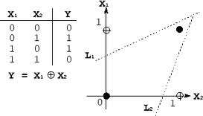
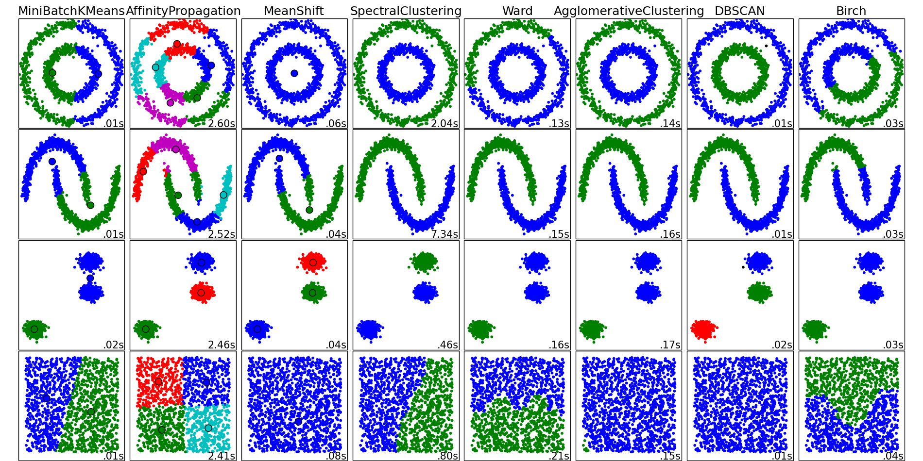

A long history of artificial problems in ML
XOR (neural networks)
Two moons and friends (clustering)
Many in the UCI repository
(regression, classification)
Toy/artificial problems in ML: crucial for demonstrating and assessing the usefulness/efficiency of new algorithms

Slide 32
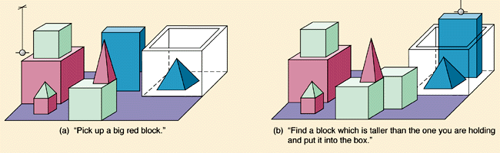
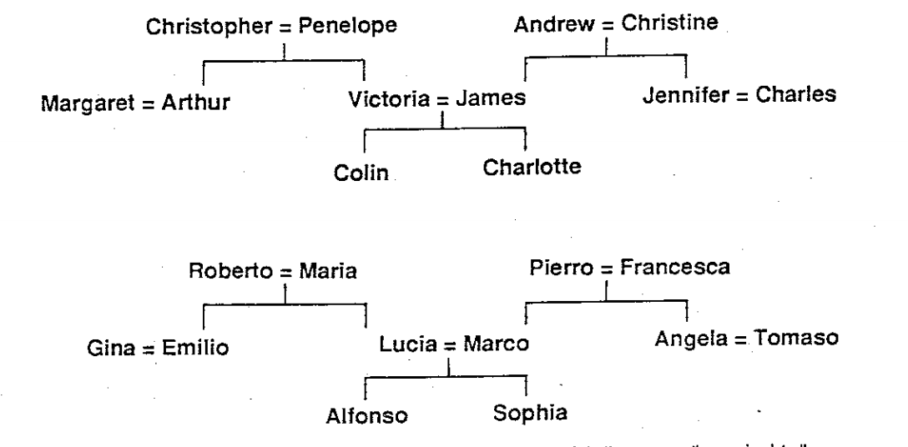
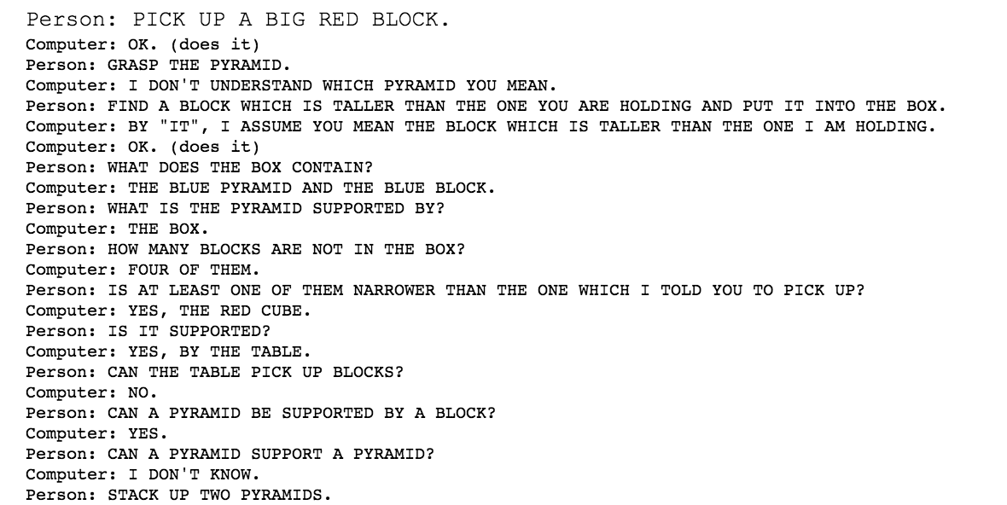
And in early AI too
Block Worlds (Winograd 1971)
Family trees (Hinton CogSci’86)

Slide 33
bAbI Tasks
Weston et al., ICLR’15
20 artificial tasks for machine reading
Answer has to be picked among a set of candidates
Each task checks one skill that a reasoning system should have.
Goal: develop systems able to solve all tasks with no task specific engineering.
A postulate is that performing well on all of them is a pre-requisite for any system aiming at understanding language and able to reason.

Slide 34
Simulation commands
go <place>
get <object>
get <object1> from <object2>
put <object1> in/on <object2>
give <object> to <person>
drop <object>
look
inventory
examine <object>
+ 2 commands for "gods'' (superusers):
create <object>
set <obj1> <relation> <obj2>

Slide 35
Example
Simple grammar
Command format
Story
jason go kitchen
jason get milk
jason go office
jason drop milk
jason go bathroom
where is milk ? A: office
where is jason? A: bathroom
Jason went to the kitchen.
Jason picked up the milk.
Jason travelled to the office.
Jason left the milk there.
Jason went to the bathroom.
Where is the milk now? A: office
Where is Jason? A: bathroom

Slide 36
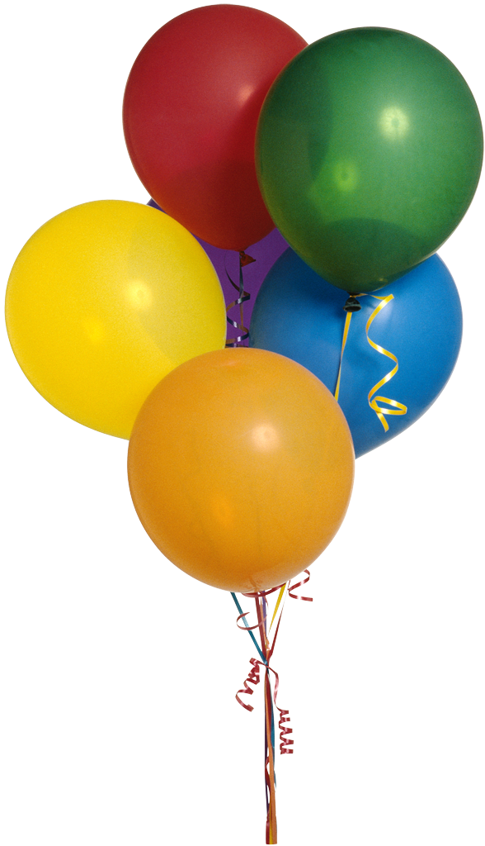
(T1) Single supporting fact “where is actor”
A single supporting fact, previously given, provides the answer.
Simplest case of this: asking for the location of a person.
John is in the playground.
Bob is in the office.
Where is John? A:playground
SUPPORTING FACT

Slide 37
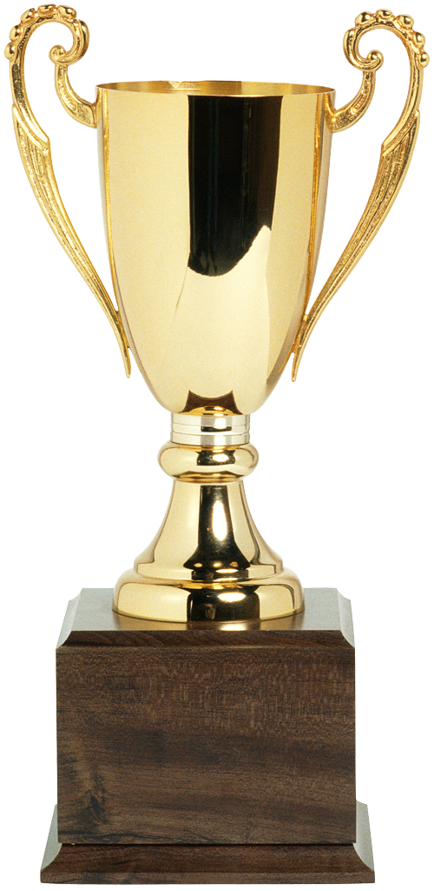
(T2) Two supporting facts “where is actor+object”
Harder task: two supporting statements have to be chained to answer
To answer the first question Where is the football? both John picked up the football and John is in the playground are supporting facts
John is in the playground.
Bob is in the office.
John picked up the football.
Bob went to the kitchen.
Where is the football? A:playground
Where was Bob before the kitchen? A:office
SUPPORTING FACT
SUPPORTING FACT

Slide 38
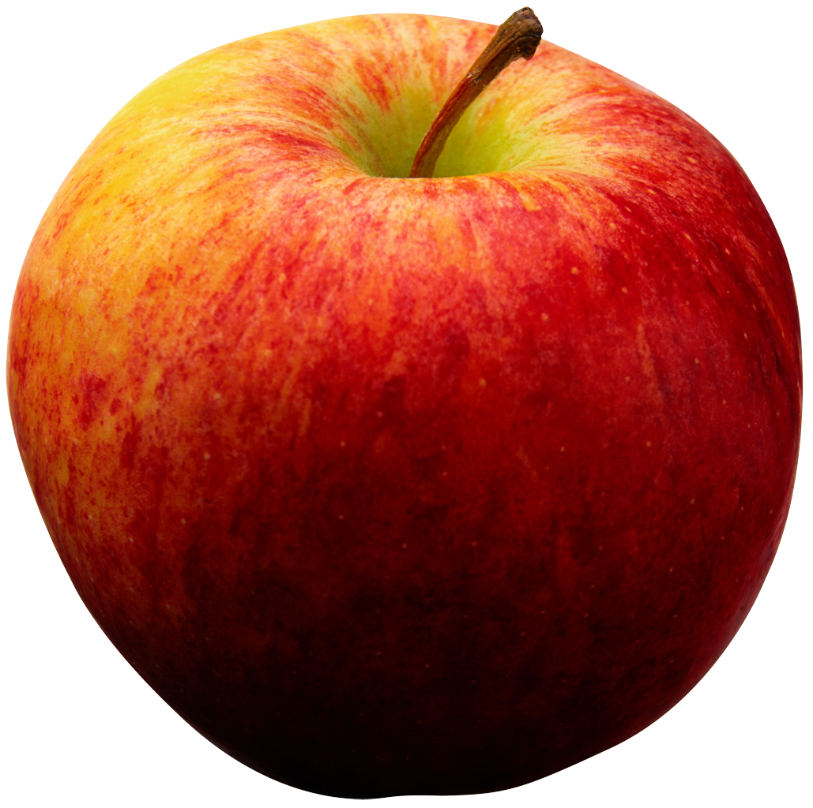
(T3) Three supporting facts
Similarly, one can make a task with three supporting facts:
The first three statements are all required to answer this.
John picked up the apple.
John went to the office.
John went to the kitchen.
John dropped the apple.
Where was the apple before the kitchen? A:office

Slide 39
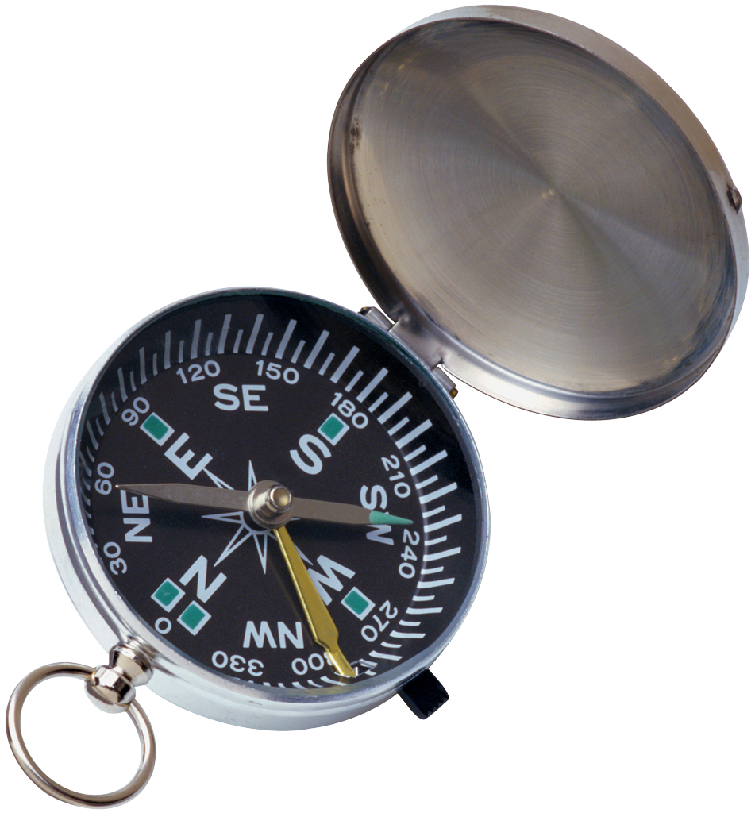
(T4) Two argument relations: subj vs. obj.
To answer questions the ability to differentiate and recognize subjects and objects is crucial
Extreme case - sentences feature re-ordered words:
The two questions above have exactly the same words, but in a different order, and different answers.
So a bag-of-words will not work.
The office is north of the bedroom.
The bedroom is north of the bathroom.
What is north of the bedroom? A:office
What is the bedroom north of? A:bathroom

Slide 40
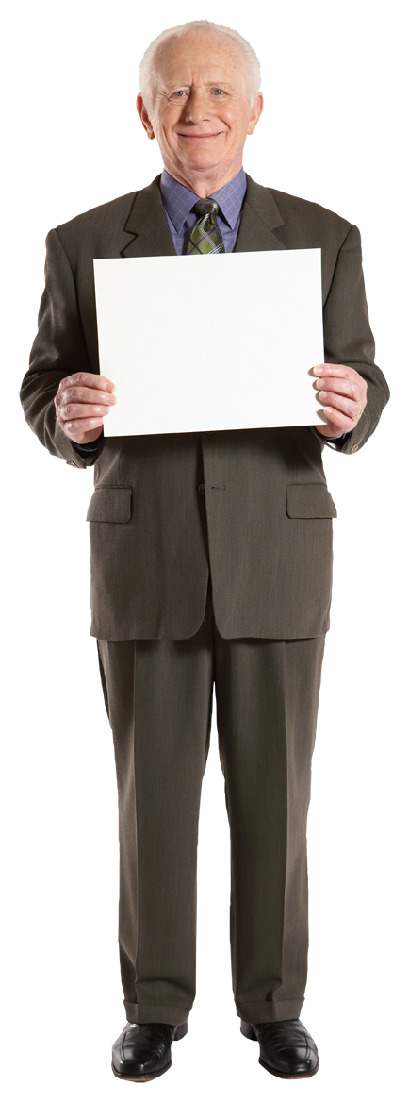

(T6) Yes/No questions
This task tests, in the simplest case possible (with a single supporting fact) the ability of a model to answer true/false type questions:
John is in the playground.
Daniel picks up the milk.
Is John in the classroom? A:no
Does Daniel have the milk? A:yes
YES
NO

Slide 41
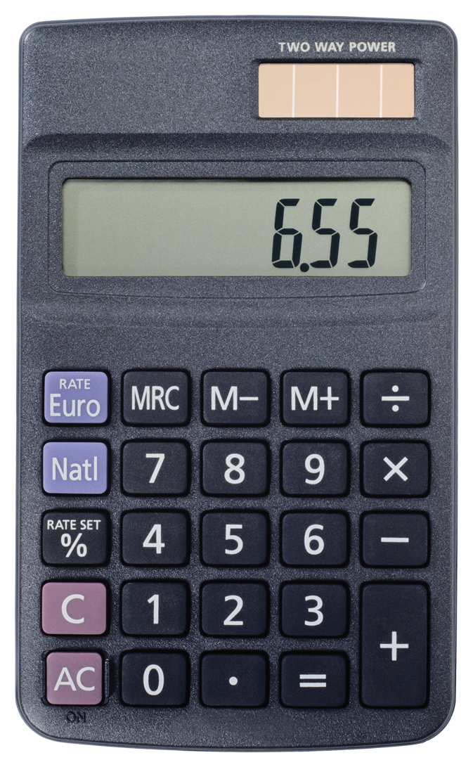
(T7) Counting
This task tests the ability of the QA system to perform simple counting operations, by asking about the number of objects with a certain property:
Daniel picked up the football.
Daniel dropped the football.
Daniel got the milk.
Daniel took the apple.
How many objects is Daniel holding? A:two

Slide 42
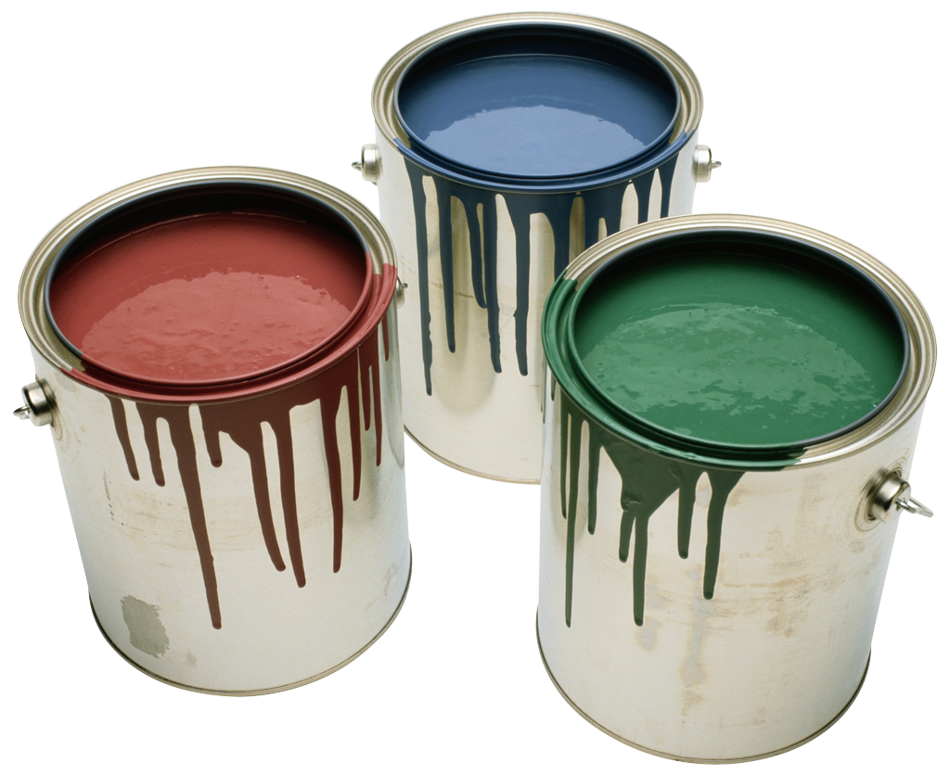
(T17) Positional reasoning
This task tests spatial reasoning:
Close from block worlds, with no vision input.
The Yes/No task (6) is a prerequisite.
The triangle is to the right of the blue square.
The red square is on top of the blue square.
The red sphere is to the right of the blue square.
Is the red sphere to the right of the blue square? A:yes
Is the red square to the left of the triangle? A:yes

Slide 43
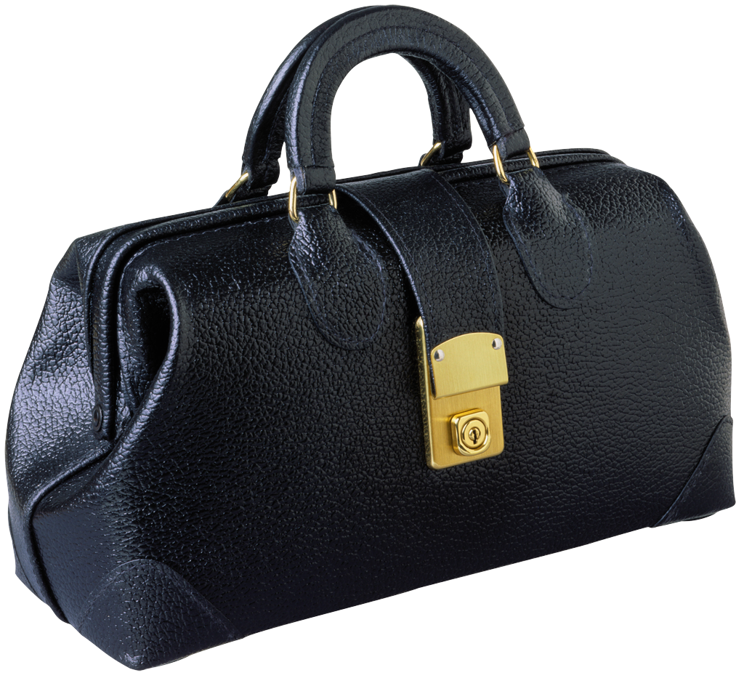
(T18) Reasoning about size
This task requires reasoning about relative size of objects :
Inspired by the commonsense reasoning examples of the Winograd schema challenge
Tasks 3 (three supporting facts) and 6 (Yes/No) are prerequisites.
The football fits in the suitcase.
The suitcase fits in the cupboard.
The box of chocolates is smaller than the football.
Will the box of chocolates fit in the suitcase? A:yes

Slide 44
Winograd Schemas
Definition: A Winograd schema is a pair of sentences that differ in only one or two words and that contain an ambiguity that is resolved in opposite ways in the two sentences and requires the use of world knowledge and reasoning for its resolution.
Levesque, AAAI’11
it = trophy or suitcase ?
More schemas here: https://cs.nyu.edu/faculty/davise/papers/WinogradSchemas/WSCollection.html
The trophy would not fit in the brown suitcase because it was too big.
The trophy would not fit in the brown suitcase because it was too small.

Slide 45
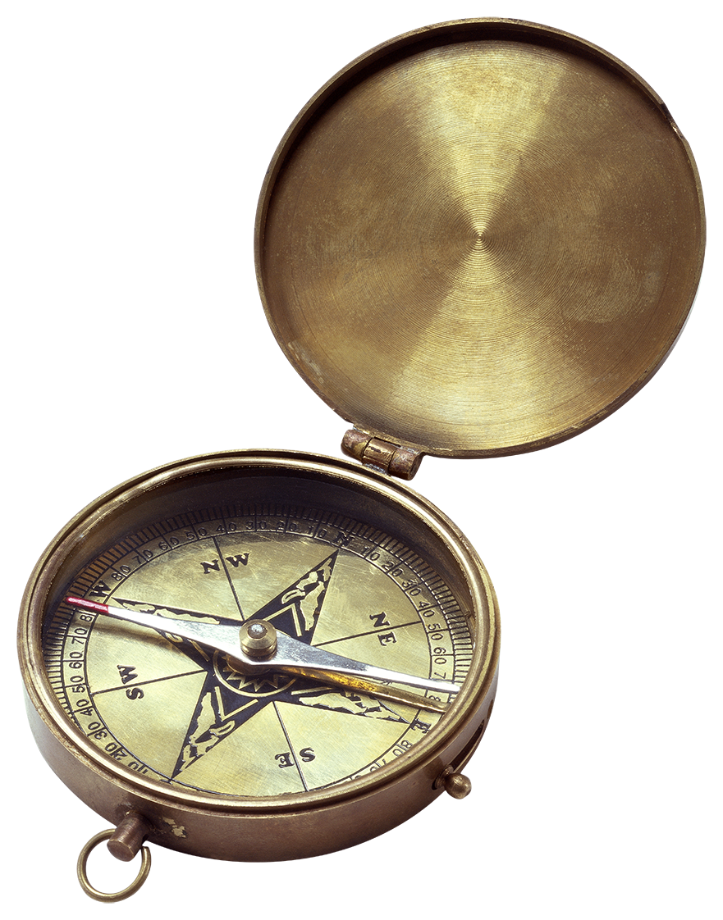
(T19) Path finding
In this task the goal is to find the path between locations:
This task is difficult because it effectively involves search.
The kitchen is north of the hallway.
The den is east of the hallway.
How do you go from den to kitchen? A:west,north

Slide 46
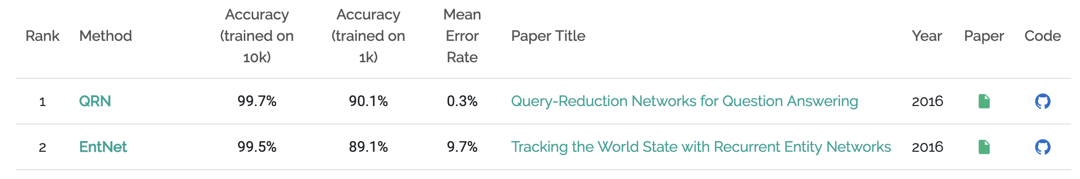
Dashboard
Training on 1k stories
Weak supervised
Fully supervised
TASK | N-grams | LSTMs | StructSVM + COREF + SRL | Attention model
T1. Single supporting fact | 36 | 50 | PASS | PASS
T2. Two supporting facts | 2 | 20 | 74 | PASS
T3. Three supporting facts | 7 | 20 | 17 | PASS
T4. Two arguments relations | 50 | 61 | PASS | PASS
T5. Three arguments relations | 20 | 70 | 83 | 84
T6. Yes/no questions | 49 | 48 | PASS | 49
T7. Counting | 52 | 49 | 69 | 73
T8. Sets | 40 | 45 | 70 | 87
T9. Simple negation | 62 | 64 | PASS | 62
T10. Indefinite knowledge | 45 | 44 | PASS | 50
T11. Basic coreference | 29 | 72 | PASS | PASS
T12. Conjunction | 9 | 74 | PASS | PASS
T13. Compound coreference | 26 | PASS | PASS | PASS
T14. Time reasoning | 19 | 27 | PASS | PASS
T15. Basic deduction | 20 | 21 | PASS | PASS
T16. Basic induction | 43 | 23 | 24 | PASS
T17. Positional reasoning | 46 | 51 | 61 | 48
T18. Size reasoning | 52 | 52 | 62 | 68
T19. Path finding | 0 | 8 | 49 | 4
T20. Agent’s motivation | 76 | 91 | PASS | PASS
Source: https://paperswithcode.com/sota/question-answering-babi

Slide 47
Artificial tasks for Machine Reading
Advantages:
Total control on the complexity of the tasks/reasoning
Clear interpretation of results
Small-ish scale so easy to prototype on them
Challenges:
How do we know that artificial data models the right problem?
By creating the tasks that we are solving, aren’t we fooling ourselves?
How transfer from artificial to real conditions?
Notes:
Discussion around these points with the students → this will be a question of the quiz

Slide 48
Other Machine Reading & QA Datasets
Dataset Name | Task Format | Supervision type | Total Size | Authors / Reference
TREC-QA | Query log, IR + free form | Human verification | 1,479 | Voorhees and Tice (2000)
QuizBowl | Trivia Question Answering | Expert Creation | 37,225 | Boyd-Graber et al (2012)
WebQuestions | NL question + KB | Google Search API & Human verification | 5,810 | Berant et al. (2013)
MCTest | Multiple Choice QA | crowdsourced | 2640 | Richardson et al. (2013)
CNN & Daily Mail | Cloze, Multiple Choice QA | Distant Supervision | 387,420 + 997,467 | Hermann et al. (2015)
WikiQA | Extractive QA/ sentence selection Â with Bing queries | crowdsourced | 3,047 | Yang et al. (2015)
bAbI | 20 complex reasoning tasks with controlled language | Automatically Generated | 20,000 | Weston et al. (2015)
SimpleQuestions | NL question + KB | KB + crowdsourced questions | 108,442 | Bordes et al (2015)
Children Book Test | Multiple Choice Cloze QA | Automatic (fill-the-blank) | 687,343 | Hill et al. (2016)
SQuAD (1.0 + 2.0) | Extractive QA | Crowdsourced | 107,702 | Rajpurkar et al (2016), Rajpurkar and Jia et al (2018)
ComplexQuestions | NL question + KB | Search API & Human verification | 2,100 | Bao et al. (2016)
MovieQA | Multiple choice QA, text & video. | crowdsourced | 14,944 | Tapawasi et al. (2016)
WhoDidWhat | Cloze, Multiple Choice QA | Distant Supervision | 205,978 | Onishi et al. (2016)
MS MARCO | Bing queries and NL answers | crowdsourced | 100,000 | Nguyen et al (2016)
Lambada | Cloze QA | Automatic (human verification) | 10,022 | Paperno et al. (2016)
WikiReading | KB query, NL text | Distant Supervision | 18.58M | Hewlett et al. (2016)
TriviaQA | Trivia Question Answering | Expert Creation + Distant Supervision | 662,659 | Joshi et al. (2017)
SciQ | Multiple choice QA | crowdsourced | 13,679 | Welbl et al. (2017)
RACE | Multiple choice Exam questions | Expert Creation | 97,687 | Lai et al. (2017)
NewsQA | Extractive QA | crowdsourced | 119,633 | Trischler et al. (2017)
AI2 Science Questions | Multiple Choice Science Exam QA | Expert Creation | 5,059 | Allen Institute for AI (2017 release)
SearchQA | Trivia questions + Search Engine Results | Expert Creation + distant supervision | 140,461 | Dunn et al. (2017)
QUASAR-S & QUASAR-T | Cloze & free-form trivia questions | Distant supervision | 37,362 + 43,013 | Dhingra et al. (2017)
Wikihop & Medhop | KB query, NL text, multiple Choice | Distant Supervision | 51,318+2,508 | Welbl et al. (2018)
NarrativeQA | free-form answer generation | crowdsourced | 46,765 | Kocisky et al. (2018)

Slide 49
Stanford Question Answering Dataset (SQuAD)
Rajpurkar et. al., EMNLP’16
Dataset size: 107,702 samples
Widely used benchmark dataset
Task: Extractive Question Answering
System has to predict the start and end position of the answer in the passage of text

Slide 50
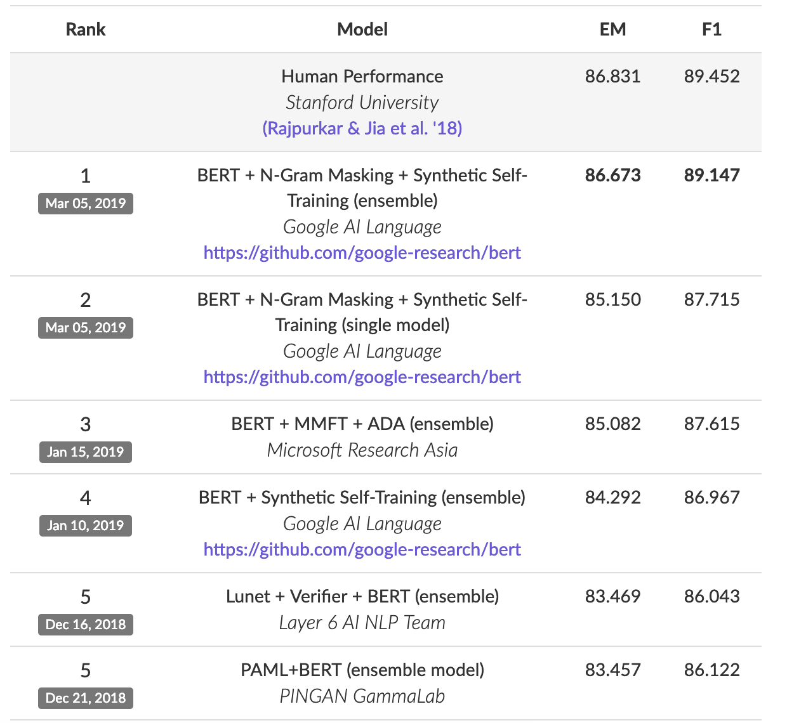
Stanford Question Answering Dataset (SQuAD)
Text Passage
Question + Answer
[...] Precipitation forms as smaller droplets coalesce via collision with other rain drops or ice crystals within a cloud. Short, intense periods of rain in scattered locations are called “showers”.
Where do water droplets collide with ice crystals to form precipitation?
Task: Given a paragraph and a question about it, predict the text span that states the correct answer.
within a cloud
Very popular leaderboard!
https://stanford-qa.com

Slide 51
Machine Reading / Models

Slide 52
End-to-end Machine Reading for Question Answering
fully differentiable model
[...] Precipitation forms as smaller droplets coalesce via collision with other rain drops or ice crystals within a cloud. Short, intense periods of rain in scattered locations are called “showers”.
?
Where do water droplets collide with ice crystals to form precipitation?
within a cloud
[Passage of Text]
[Meaning]
[Information Need]

Slide 53
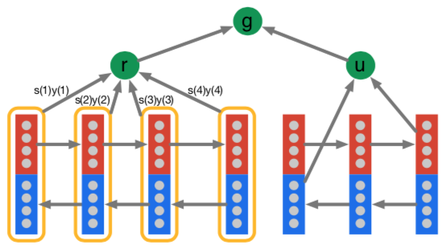
End-to-end Machine Reading for Question Answering
“Simple” Architecture
[...] Precipitation forms as smaller droplets coalesce via collision with other rain drops or ice crystals within a cloud. Short, intense periods of rain in scattered locations are called “showers”.
?
Where do water droplets collide with ice crystals to form precipitation?
within a cloud
Hermann et al., 2015
[Passage of Text]
[Meaning]
[Information Need]
Notes:
This example architecture is in fact the current state-of-the art model.
We will later on, on a high level, understand how it works
For now, we will have a look at a simpler model

Slide 54
The Attentive Reader Model: Overview
Hermann et al., NIPS’15
answer
‘early’ neural model for Machine Reading
main components reused in many other models
Precipitation
forms
as
smaller
How
do
water
Modified visualization from Hermann et. al. NIPS’15
Notes:
Say that we model symbols by one-hot vectors. We embed by a linear projection to much lower dimensionality → solves the aformentioned problem of high-dimensional feature spaces, however, such models have at least 1 hidden layer, no linear models anymore → backpropagation and DL to the rescue.
Projection matrix is often called the embedding matrix. Talk about word embeddings, and or character embeddings.

Slide 55
The Attentive Reader Model: Overview
Answer Selection: answer prediction
answer
Sequence Interaction:
Matching text with question
Composition: incorporating context around words
Input: Representing symbols as vectors
Precipitation
forms
as
smaller
How
do
water
Modified visualization from Hermann et. al. NIPS’15
Notes:
Say that we model symbols by one-hot vectors. We embed by a linear projection to much lower dimensionality → solves the aformentioned problem of high-dimensional feature spaces, however, such models have at least 1 hidden layer, no linear models anymore → backpropagation and DL to the rescue.
Projection matrix is often called the embedding matrix. Talk about word embeddings, and or character embeddings.

Slide 56
The Attentive Reader Model: Overview
answer
Input: Representing symbols as vectors
Precipitation
forms
as
smaller
How
do
water
Modified visualization from Hermann et. al. NIPS’15
Notes:
Say that we model symbols by one-hot vectors. We embed by a linear projection to much lower dimensionality → solves the aformentioned problem of high-dimensional feature spaces, however, such models have at least 1 hidden layer, no linear models anymore → backpropagation and DL to the rescue.
Projection matrix is often called the embedding matrix. Talk about word embeddings, and or character embeddings.

Slide 57

Representations for words: Embeddings
rain
precipitation
mozzarella
Similar meaning of words → similar vector representations – see previous lectures!

Slide 58
The Attentive Reader Model: Overview
answer
Composition: incorporating context around words
Input: Representing symbols as vectors
Precipitation
forms
as
smaller
How
do
water
Modified visualization from Hermann et. al. NIPS’15
Notes:
Say that we model symbols by one-hot vectors. We embed by a linear projection to much lower dimensionality → solves the aformentioned problem of high-dimensional feature spaces, however, such models have at least 1 hidden layer, no linear models anymore → backpropagation and DL to the rescue.
Projection matrix is often called the embedding matrix. Talk about word embeddings, and or character embeddings.

Slide 59
Language is compositional
Documents
Paragraphs
Sentences
Clauses
Phrases
Words
Characters
Challenges
Inductive bias: which composition function to use?
sequence, tree or more general graph structures?
varies for different levels
Capturing long-range dependencies
co-reference (tracking entities)
effective information flow: ease of learning
Notes:
Effective information flow:
How easy is it to condition relevant constituents on one another

Slide 60
Representing Words in Context
“move from Gospić to Prague”
“leave Gospić for Prague”
“leave Prague for Gospić”
Word vector for Prague
Word vector for Prague
Word vector for Prague
Word representations should vary depending on context
Notes:
In our example with Tesla, we see that the same idea is expressed in two different ways
Our goal is to learn representations that...

Slide 61
Representing Words in Context
“move from Gospić to Prague”
“leave Gospić for Prague”
“leave Prague for Gospić”
Contextual representation of Prague
Contextual representation of Prague
Contextual representation of Prague
Word representations should vary depending on context
Contextual word representation:
a word representation, computed conditionally on the given context
Notes:
Vector for Prague should be different depending on context.
Representation should be conditioned on context

Slide 62
Representing Words in Context
composition of word vectors into contextualized word representations
use vector composition function
“move from Gospić to Prague”
Contextual representations
Word representations
move
from
Gospić
to
Prague

Slide 63

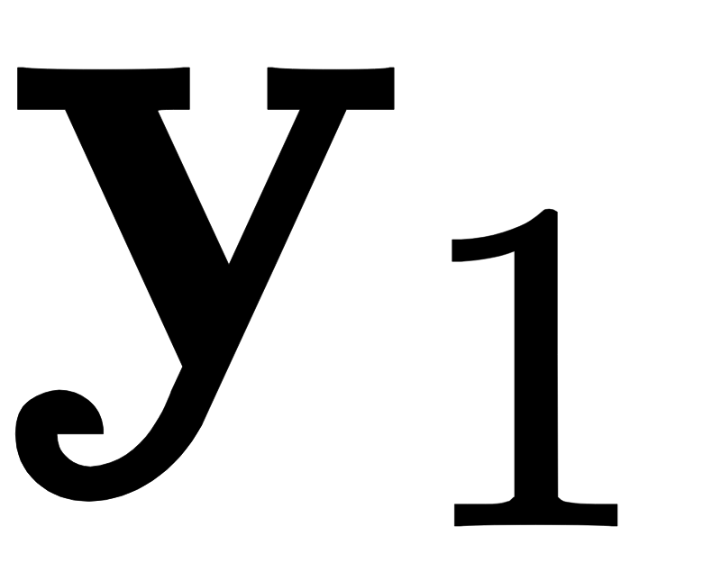
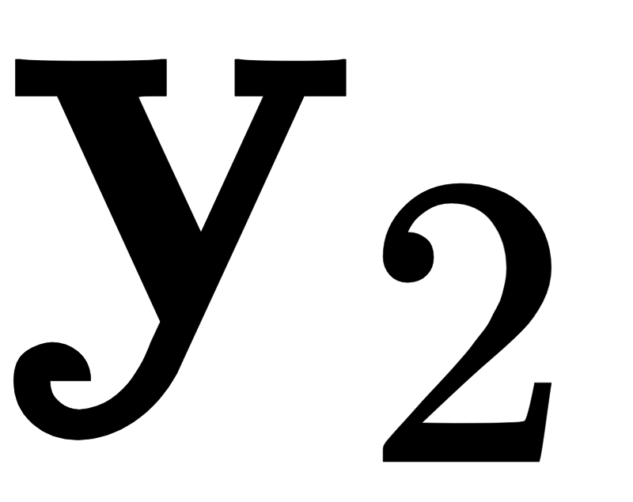
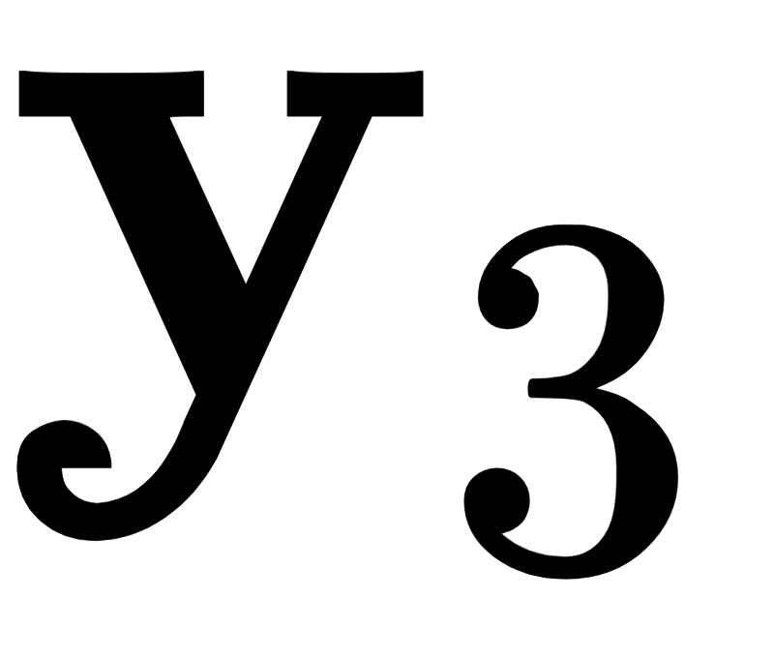
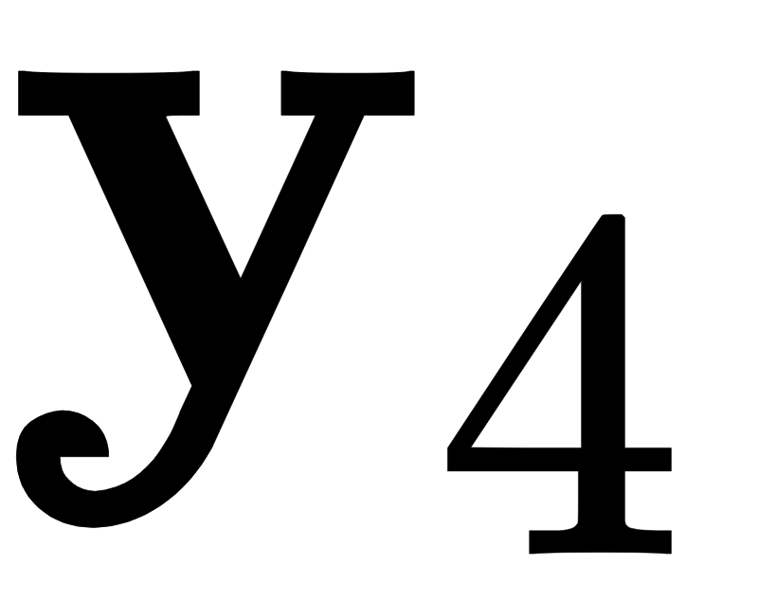
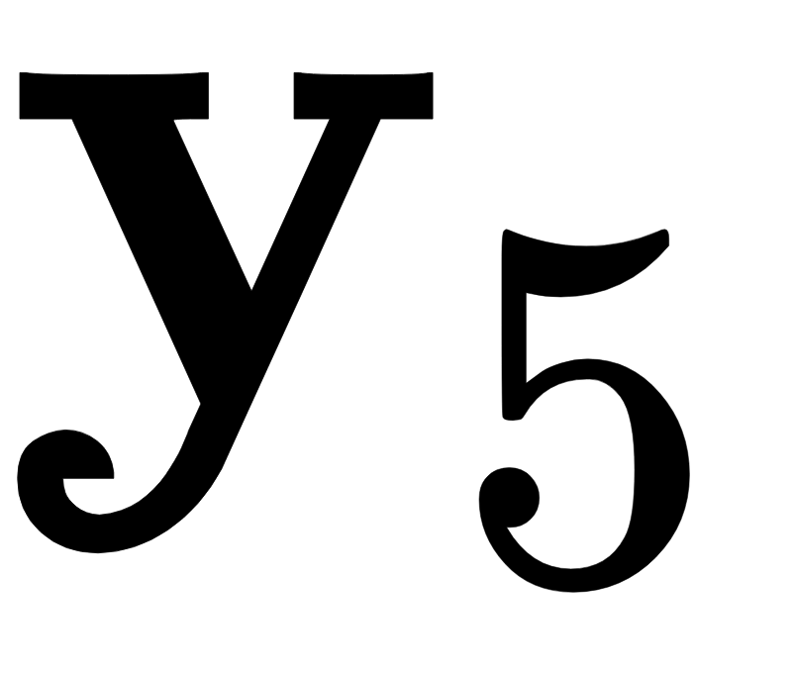

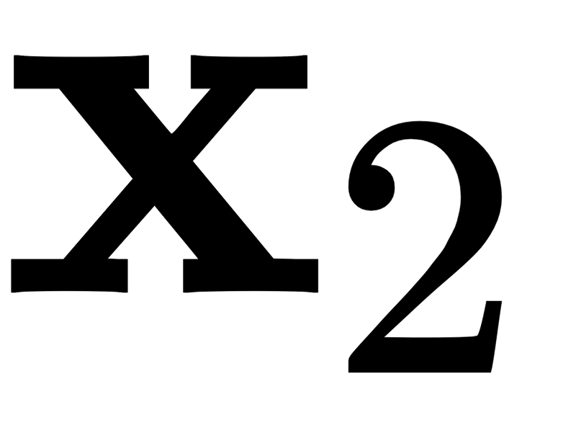
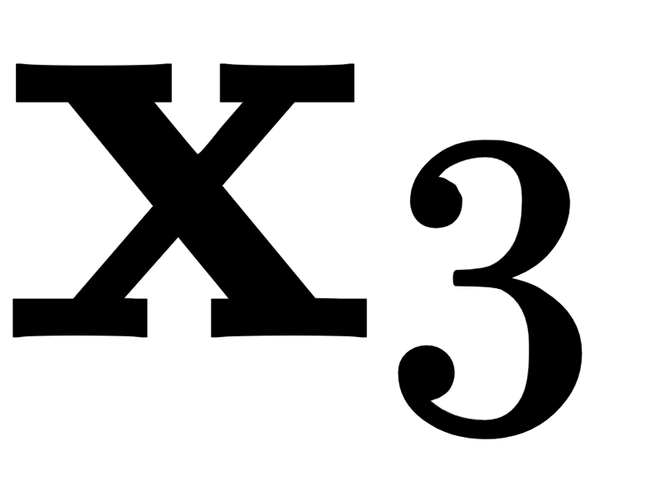
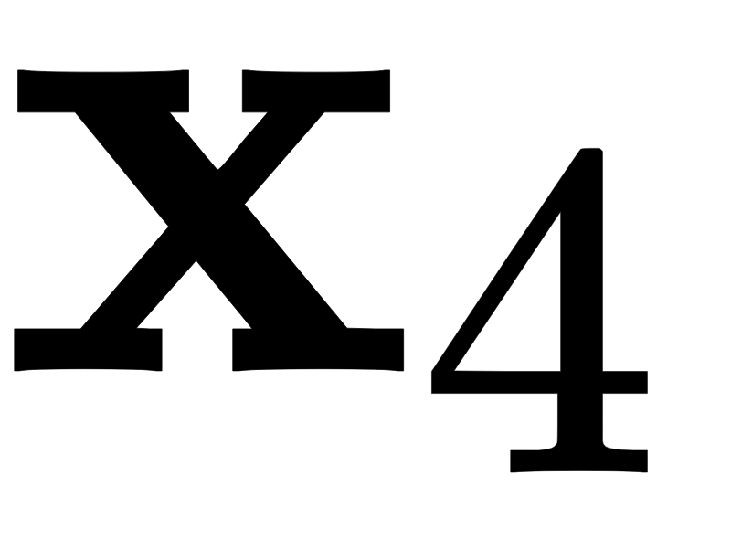


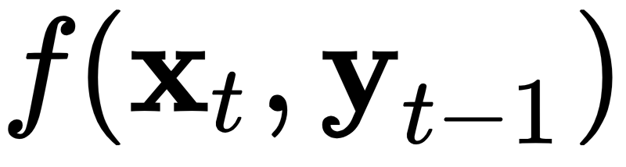
Recurrent Neural Network Layers
Idea: text as sequence
Prominent types: LSTM, GRU
Inductive bias: Recency
more recent symbols have bigger impact on hidden state
Advantages
everything is connected
easy to train and robust in practice
Disadvantages
Slow → computation time linear in length of text
not good for (very) long range dependencies
Good for: sentences, small paragraphs
move
from
Gospić
to
Prague
Tree-variants:
TreeLSTM (Tai et al., SCL’15)
RNN Grammars (Dyer et al. NAACL’16)
Bias towards syntactic hierarchy

Slide 64
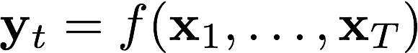
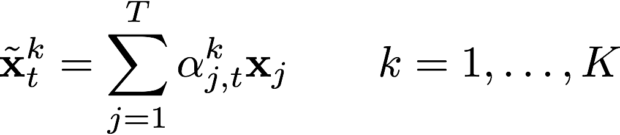
Self-Attention Layer
Idea: latent graph on text
Inductive bias:
relationships between word pairs
compute K separate weighted word representation(s) of the context for each word t
Advantages
can capture long-range dependencies
Parallelizable and fast
Disadvantages
careful setup of hyper-parameters
potentially memory intensive computation of attention weights for large contexts, O(T * T * K)
Good for: phrases, sentences, paragraphs
move
from
Gospić
to
Prague
Notes:
- The new kid on the block!

Slide 65
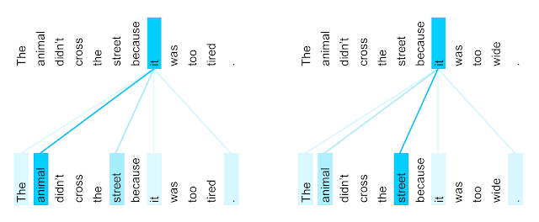
Self-Attention Layer
Graph with weighted edges of K types
Can capture:
coreference chains
syntactic dependency structure in text
Transformer Self-Attention Coreference Visualization https://ai.googleblog.com/2017/08/transformer-novel-neural-network.html
Notes:
Connection with Winograd schemas

Slide 66
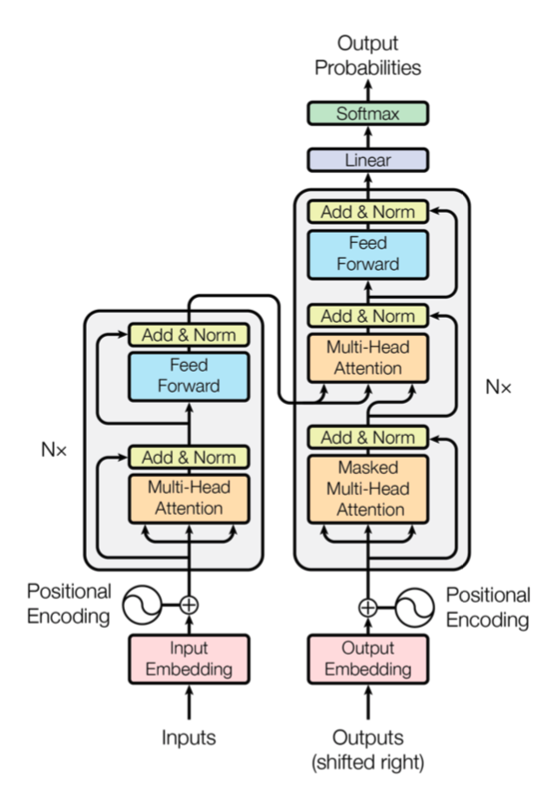
Transformer
Vaswani et al., NIPS’17
Residual connections before and after multi-head attention
Decoder uses both self attention and encoder attention
Figure from Vaswani et al., NIPS’17

Slide 67
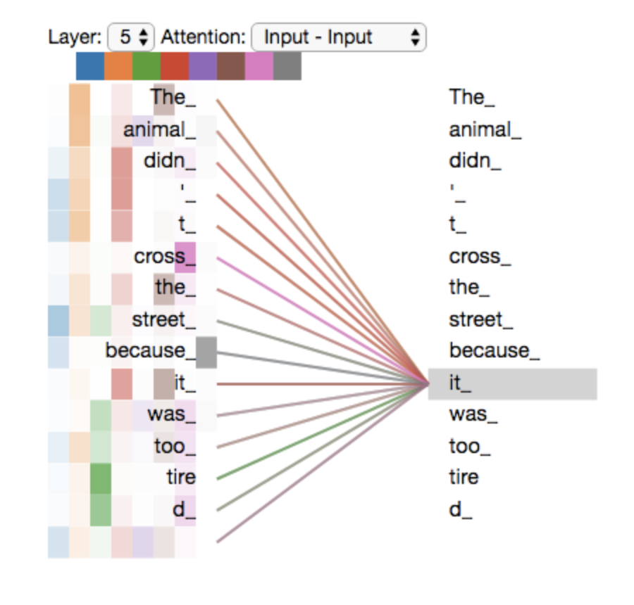
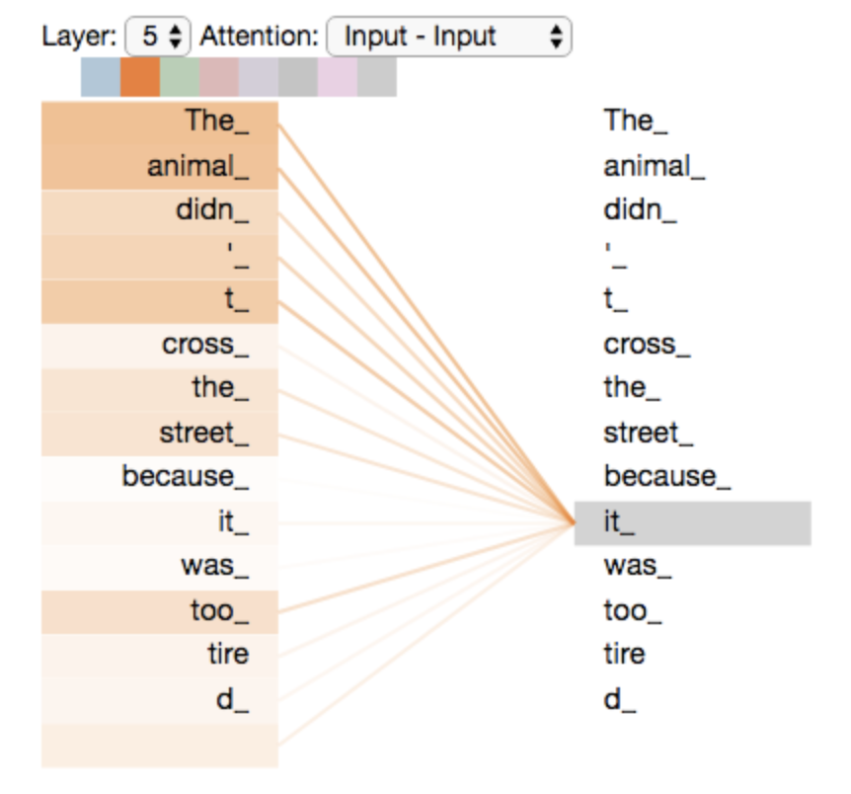
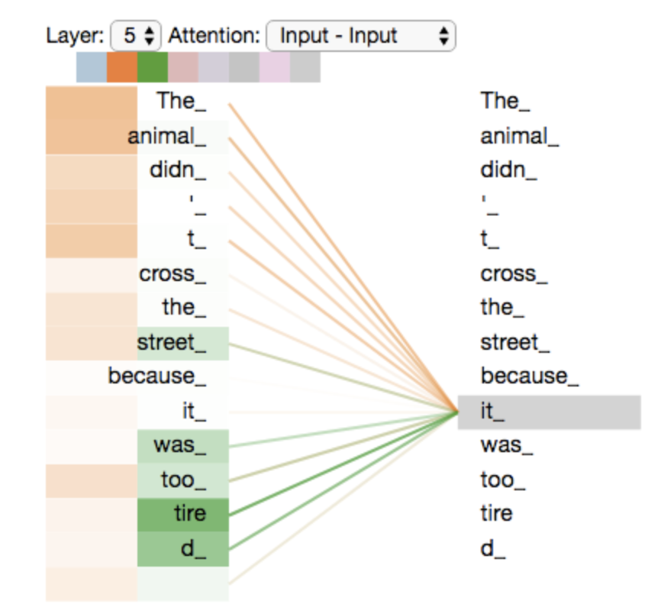
Multi-head attention
Figures from http://jalammar.github.io/illustrated-transformer/

Slide 68
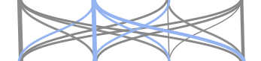
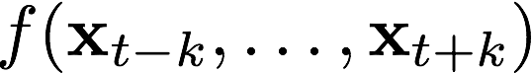
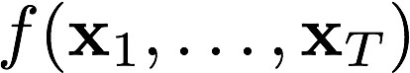
Compositional Sequence Encoders - Overview
Language is compositional!
Characters → Words → Phrases → Clauses → Sentences → Paragraphs → Documents
Architecture | RNN (LSTM, GRU) | CNN | Self-Attention
Illustration
Function
Advantages | - unlimited context - recency bias | - parallelizable → fast - local n-gram patterns | - parallelizable → fast - long-range dep
Disadvantages | - slower - strong recency bias - long-range dep | - limited context - strong locality bias - long-range dep | - harder to train - careful setup of hyper-parameters

Slide 69
The Attentive Reader Model: Overview
answer
Sequence Interaction:
Matching text with question
Composition: incorporating context around words
Input: Representing symbols as vectors
Precipitation
forms
as
smaller
How
do
water
Modified visualization from Hermann et. al. NIPS’15
Notes:
Say that we model symbols by one-hot vectors. We embed by a linear projection to much lower dimensionality → solves the aformentioned problem of high-dimensional feature spaces, however, such models have at least 1 hidden layer, no linear models anymore → backpropagation and DL to the rescue.
Projection matrix is often called the embedding matrix. Talk about word embeddings, and or character embeddings.

Slide 70
Modelling sequence interactions
Why? QA requires matching between question and text.
condition text representation on question (and vice versa)
“Naive approach”: concatenation
append question after text, use RNN with longer sequence
Problem with naive approach:
Long range dependencies: Many recurrent steps between answer and question → dilution of signal

Slide 71
Modelling sequence interactions
Combination of question and text representation
answer
attention-weighted sum of contextualised word representations
Precipitation
forms
as
smaller
How
do
water
Modified visualization from Hermann et. al. NIPS’15
Notes:
Say that we model symbols by one-hot vectors. We embed by a linear projection to much lower dimensionality → solves the aformentioned problem of high-dimensional feature spaces, however, such models have at least 1 hidden layer, no linear models anymore → backpropagation and DL to the rescue.
Projection matrix is often called the embedding matrix. Talk about word embeddings, and or character embeddings.

Slide 72
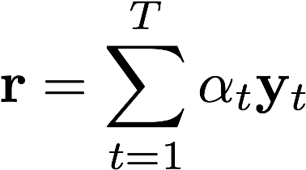



Modelling sequence interactions: Attention
Attention: relevance-weighted pooling of vectors across sequence
Attention mask computed can be conditional on question and text
Determines relevance of tokens for answering the question
Sequence aggregate
Contextual representations
… “move from Gospić to Prague ...

Slide 73

Modelling sequence interactions: Memory Networks
Sukhbaatar et al., NIPS’15 / Miller et al., EMNLP’16
Representation of the question + story
Where is the milk?
hallway
(m₁, m₂, m₃, m₄, …)
(m₁, m₂, m₃, m₄, …)
John
Memories
John dropped the milk.
John took the milk there.
Sandra went to the bathroom.
John moved to the hallway.
Mary went back to the bedroom.
Memories
m1: John dropped the milk.
m2: John took the milk there.
m4: John moved to the hallway.
m5: Mary went back to the bedroom.
m3: Sandra went to the bathroom.

Slide 74
Example: Learned attention patterns
End-to-end Memory Networks on bAbI tasks
Visualization from Sukhbaatar et. al., NIPS’15

Slide 75

Example: Learned attention patterns
Memory Networks on Children Book Test dataset
Visualization from Hill et. al., ICLR’16

Slide 76

Example: Learned attention patterns
Attentive Reader on QACNN/DailyMail dataset
Visualization from Hermann et. al. NIPS’15

Slide 77
The Attentive Reader Model: Overview
Answer Selection: answer prediction
answer
Sequence Interaction:
Matching text with question
Composition: incorporating context around words
Input: Representing symbols as vectors
Precipitation
forms
as
smaller
How
do
water
Modified visualization from Hermann et. al. NIPS’15
Notes:
Say that we model symbols by one-hot vectors. We embed by a linear projection to much lower dimensionality → solves the aformentioned problem of high-dimensional feature spaces, however, such models have at least 1 hidden layer, no linear models anymore → backpropagation and DL to the rescue.
Projection matrix is often called the embedding matrix. Talk about word embeddings, and or character embeddings.

Slide 78
Answer prediction
Usually linear projection
Probability distribution over different answer options
Multiple choices: candidates (as in bAbI)
Spans in text -- distribution over positions for beginning and end (as in SQuAD)
Training:
Cross-entropy loss
Ranking loss

Slide 79
Answer selection: Ranking (Memory Networks)
Sukhbaatar et al., NIPS’15 / Miller et al., EMNLP’16
Where is the milk?
hallway
John
(m₁, m₂, m₃, m₄, …)
milk
(m₁, m₂, m₃, m₄, …)
John
Memories
John dropped the milk.
John took the milk there.
Sandra went to the bathroom.
John moved to the hallway.
Mary went back to the bedroom.
Memories
hallway
m1: John dropped the milk.
m2: John took the milk there.
m4: John moved to the hallway.
m5: Mary went back to the bedroom.
m3: Sandra went to the bathroom.
office
…

Slide 80
The Attentive Reader Model: Overview
Answer Selection: answer prediction
answer
Sequence Interaction:
Matching text with question
Composition: incorporating context around words
Input: Representing symbols as vectors
Precipitation
forms
as
smaller
How
do
water
Modified visualization from Hermann et. al. NIPS’15
Notes:
Say that we model symbols by one-hot vectors. We embed by a linear projection to much lower dimensionality → solves the aformentioned problem of high-dimensional feature spaces, however, such models have at least 1 hidden layer, no linear models anymore → backpropagation and DL to the rescue.
Projection matrix is often called the embedding matrix. Talk about word embeddings, and or character embeddings.

Slide 81
Conclusion
We gathered all ingredients to build state-of-the-art supervised Machine Reading systems!
architectures work well in practice ... as long as we stay in-domain and questions are simple
We covered only extractive and multiple choice questions settings but there is also generative machine reading
Practice in Labs tomorrow on bAbI!

Slide 82
Machine Reading / Current Trend

Slide 83
Supervised training
Neural net encoder for MR
[...] Precipitation forms as smaller droplets coalesce via collision with other rain drops or ice crystals within a cloud. Short, intense periods of rain in scattered locations are called “showers”.
?
Where do water droplets collide with ice crystals to form precipitation?
within a cloud
[Passage of Text]
[Meaning]
[Information Need]

Slide 84
Unsupervised pretrained representations
Neural net encoder for (just) text
In January 1880, two of Tesla's uncles put together enough money to help him leave Gospić for Prague where he was to study. Unfortunately, he arrived too late to enrol at Charles-Ferdinand University; he never studied Greek, a required subject; and he was illiterate in Czech, another required subject. Tesla did, however, attend lectures at the university, although, as an auditor, he did not receive grades for the courses.
?
In January 1880, two of Tesla's uncles put together enough money to help him leave Gospić for Prague where he was to study. Unfortunately, he arrived too late to enrol at Charles-Ferdinand University; he never studied Greek, a required subject; and he was illiterate in Czech, another required subject. Tesla did, however, attend lectures at the university, although, as an auditor, he did not receive grades for the courses.
In January 1880, two of Tesla's uncles put together enough money to help him leave Gospić for Prague where he was to study. Unfortunately, he arrived too late to enrol at Charles-Ferdinand University; he never studied Greek, a required subject; and he was illiterate in Czech, another required subject. Tesla did, however, attend lectures at the university, although, as an auditor, he did not receive grades for the courses.
In January 1880, two of Tesla's uncles put together enough money to help him leave Gospić for Prague where he was to study. Unfortunately, he arrived too late to enrol at Charles-Ferdinand University; he never studied Greek, a required subject; and he was illiterate in Czech, another required subject. Tesla did, however, attend lectures at the university, although, as an auditor, he did not receive grades for the courses.
[...] Precipitation forms as smaller droplets coalesce via collision with other rain drops or ice crystals within a cloud. Short, intense periods of rain in scattered locations are called “showers”.
[...] Precipitation forms as smaller droplets coalesce via collision with other rain drops or ice crystals within a cloud. Short, intense periods of rain in scattered locations are called “showers”.
[A lot of text]
[Meaning]
[A lot of text]

Slide 85


Lifting over pretrained representations
Pretrained Language Model
Transfer
Machine Reading

Slide 86
How is this different from pretrained word embeddings?
Pretrained Word Embeddings (word2vec)
Predicting co-occurring of words
Independent of other context
Pretrained Contextualized Embeddings (e.g. ELMo, BERT)
Predicting whole text (using LSTM, or Self-Attention)
Full dependence on other context

Slide 87

ELMo: Embeddings from Language Models
Peters et al., NAACL’18
Train a BiLSTM for Bidirectional language modeling on a large dataset
Run the sentence to encode through both forward and backward LSTMs
Combine forward and backward representations into final contextual embeddings

Slide 88

ELMo: Embeddings from Language Models
Figures from http://jalammar.github.io/illustrated-bert/

Slide 89

ELMo: Embeddings from Language Models
Figures from http://jalammar.github.io/illustrated-bert/

Slide 90

ELMo: Embeddings from Language Models
Figures from http://jalammar.github.io/illustrated-bert/

Slide 91

ELMo performance
Machine Reading-
Textual Entailment -
Semantic Labeling - Coreference Resolution - Entity Extraction - Sentiment Analysis -

Slide 92

What is ELMo learning ?
Meaning of words in context
POS, word sense, etc.

Slide 93
Problems with ELMo
Need to use different architectures for different tasks
Retraining models is slow, transfer learning is fast
Need to deal with long term dependencies in LSTMs!

Slide 94
BERT - Bidirectional Encoder Representations from Transformers
Devlin et al., NAACL’19
Solutions: use Transformer + encoder layers instead of decoder layers
(OpenAI GPT)
Innovation with multiple pretraining tasks

Slide 95
BERT – Pretraining 1: masked language modeling
Given a sentence with some words masked at random, can we predict them?
Randomly select 15% of tokens to be replaced with “<MASK>”

Slide 96

BERT – Pretraining 1: masked language modeling
Figures from http://jalammar.github.io/illustrated-bert/

Slide 97
BERT – Pretraining 2: next sentence prediction
Given two sentences, does the first follow the second?
Teaches BERT about relationship between two sentences
50% of the time the actual next sentence, 50% random

Slide 98

BERT – Pretraining 2: next sentence prediction
Figures from http://jalammar.github.io/illustrated-bert/

Slide 99


BERT – Fine-tuning for Classification
Single sentence classification
Sentiment analysis, spam detection, etc.
Pair of sentences classification
Entailment, paraphrase detection, etc.
Figures from Devlin et al. 18'

Slide 100


BERT – Fine-tuning for Machine Reading
Figures from Devlin et al. 18'

Slide 101
Open Domain Question Answering
Is Machine Reading actually useful?

Slide 102
Motivation 1: Information Overload
[Information Need]
uses for

Slide 103
Motivation 2: The Knowledge Acquisition Bottleneck
“The problem of knowledge acquisition is the critical bottleneck problem in artificial intelligence.” E. A. Feigenbaum 1984
[Knowledge]
[Meaning]
[Information Need]
uses for

Slide 104
Open domain Question Answering
Open domain QA: answer any question using very large knowledge sources
Goes beyond Machines Reading that expects a paragraph to be given
Open domain = question on any topic not a restricted subset
In the following
Traditional approaches using Knowledge Bases
New approaches based on end-to-end Machine Reading

Slide 105
“Traditional” NLP for open domain QA
Knowledge
WordNet, FreeBase ...
Intensive feature engineering, including information from external resources such as knowledge bases
Tokenization
Preprocessing
Segmentation
POS Tagging
Semantic parse
Answer
Syntactic Analysis
Syntactic Parsing
NER Tagging
Semantic Analysis
Relation Extraction
Notes:
Relies on rather complicated pipelines that include various linguistic pre-processing steps. Each is prone to errors which will propagate through the pipeline.
Requires intensive feature engineering. Typical feature spaces are very high dimensional (several millions), mostly due to the large vocabularies we are dealing with.
Simple ML models (e.g. logistic regression)
→ Problems: complicated -> high entry barrier, error propagation, over-fitting

Slide 106

Semantic Parsing
Ewan forgot the mozarella in his car
[Text]
[Meaning]
[Information Need]
Semantic parses are logical forms in PROLOG, SQL, SPARQL, etc.

Slide 107

Knowledge Bases
KB: structured repository of knowledge (usually relational DB)
Goal: encode knowledge so that it can be queried by semantic parses efficiently
Scale can be huge: billions of facts, millions of entities
KB can be generic or specific
Examples: Cyc, WikiData, DBPedia, Google KG, GeneOntology, IMDB, etc.
Key challenge is their construction!
Manually: Crowdsourcing, paid experts
Automatically: Information extraction or Automatic KB Construction

Slide 108
Automatic Knowledge Base Construction
In January 1880, two of Tesla's uncles put together enough money to help him leave Gospić for Prague where he was to study. Unfortunately, he arrived too late to enrol at Charles-Ferdinand University; he never studied Greek, a required subject; and he was illiterate in Czech, another required subject. Tesla did, however, attend lectures at the university, although, as an auditor, he did not receive grades for the courses.
In January 1880, two of Tesla's uncles put together enough money to help him leave Gospić for Prague where he was to study. Unfortunately, he arrived too late to enrol at Charles-Ferdinand University; he never studied Greek, a required subject; and he was illiterate in Czech, another required subject. Tesla did, however, attend lectures at the university, although, as an auditor, he did not receive grades for the courses.
In January 1880, two of Tesla's uncles put together enough money to help him leave Gospić for Prague where he was to study. Unfortunately, he arrived too late to enrol at Charles-Ferdinand University; he never studied Greek, a required subject; and he was illiterate in Czech, another required subject. Tesla did, however, attend lectures at the university, although, as an auditor, he did not receive grades for the courses.
Tesla
moveTo
Prague
[Text]
[Meaning]
[Information Need]

Slide 109
Knowledge Graph Construction
In January 1880, two of Tesla's uncles put together enough money to help him leave Gospić for Prague where he was to study. Unfortunately, he arrived too late to enrol at Charles-Ferdinand University; he never studied Greek, a required subject; and he was illiterate in Czech, another required subject. Tesla did, however, attend lectures at the university, although, as an auditor, he did not receive grades for the courses.
What city did Tesla move to in 1880?
Q
In January 1880, two of Tesla's uncles put together enough money to help him leave Gospić for Prague where he was to study. Unfortunately, he arrived too late to enrol at Charles-Ferdinand University; he never studied Greek, a required subject; and he was illiterate in Czech, another required subject. Tesla did, however, attend lectures at the university, although, as an auditor, he did not receive grades for the courses.
Tesla
In January 1880, two of Tesla's uncles put together enough money to help him leave Gospić for Prague where he was to study. Unfortunately, he arrived too late to enrol at Charles-Ferdinand University; he never studied Greek, a required subject; and he was illiterate in Czech, another required subject. Tesla did, however, attend lectures at the university, although, as an auditor, he did not receive grades for the courses.
moveTo
Prague
a
Prague
A
[Text]
r
[Meaning]
a
X
Y

Slide 110
Knowledge Graph Construction
In January 1880, two of Tesla's uncles put together enough money to help him leave Gospić for Prague where he was to study. Unfortunately, he arrived too late to enrol at Charles-Ferdinand University; he never studied Greek, a required subject; and he was illiterate in Czech, another required subject. Tesla did, however, attend lectures at the university, although, as an auditor, he did not receive grades for the courses.
In January 1880, two of Tesla's uncles put together enough money to help him leave Gospić for Prague where he was to study. Unfortunately, he arrived too late to enrol at Charles-Ferdinand University; he never studied Greek, a required subject; and he was illiterate in Czech, another required subject. Tesla did, however, attend lectures at the university, although, as an auditor, he did not receive grades for the courses.
Tesla
In January 1880, two of Tesla's uncles put together enough money to help him leave Gospić for Prague where he was to study. Unfortunately, he arrived too late to enrol at Charles-Ferdinand University; he never studied Greek, a required subject; and he was illiterate in Czech, another required subject. Tesla did, however, attend lectures at the university, although, as an auditor, he did not receive grades for the courses.
moveTo
Prague
[Text]
r
[Meaning]
X
Y

Slide 111
Entity Extraction
In January 1880, two of Tesla's uncles put together enough money to help him leave Gospić for Prague where he was to study. Unfortunately, he arrived too late to enrol at Charles-Ferdinand University; he never studied Greek, a required subject; and he was illiterate in Czech, another required subject. Tesla did, however, attend lectures at the university, although, as an auditor, he did not receive grades for the courses.
In January 1880, two of Tesla's uncles put together enough money to help him leave Gospić for Prague where he was to study. Unfortunately, he arrived too late to enrol at Charles-Ferdinand University; he never studied Greek, a required subject; and he was illiterate in Czech, another required subject. Tesla did, however, attend lectures at the university, although, as an auditor, he did not receive grades for the courses.
Two of Tesla's uncles put together enough money to help him leave Gospić for Prague
Linear Chain CRF
Bi-directional RNNs
Hybrid RNN & CRFs
[Text]
r
[Meaning]
X
Y
Person
Location
Notes:
References?

Slide 112
Challenge: Ambiguity
In January 1880, two of Tesla's uncles put together enough money to help him leave Gospić for Prague where he was to study. Unfortunately, he arrived too late to enrol at Charles-Ferdinand University; he never studied Greek, a required subject; and he was illiterate in Czech, another required subject. Tesla did, however, attend lectures at the university, although, as an auditor, he did not receive grades for the courses.
In January 1880, two of Tesla's uncles put together enough money to help him leave Gospić for Prague where he was to study. Unfortunately, he arrived too late to enrol at Charles-Ferdinand University; he never studied Greek, a required subject; and he was illiterate in Czech, another required subject. Tesla did, however, attend lectures at the university, although, as an auditor, he did not receive grades for the courses.
Two of Tesla's uncles put together enough money to help him leave Gospić for Prague
Person?
Brand?

Slide 113
Conditional Random Fields with RNN Potentials
Huang et al., 2015
O
O
P
O
O
CRF
In January 1880, two of Tesla's uncles put together enough money to help him leave Gospić for Prague where he was to study. Unfortunately, he arrived too late to enrol at Charles-Ferdinand University; he never studied Greek, a required subject; and he was illiterate in Czech, another required subject. Tesla did, however, attend lectures at the university, although, as an auditor, he did not receive grades for the courses.
In January 1880, two of Tesla's uncles put together enough money to help him leave Gospić for Prague where he was to study. Unfortunately, he arrived too late to enrol at Charles-Ferdinand University; he never studied Greek, a required subject; and he was illiterate in Czech, another required subject. Tesla did, however, attend lectures at the university, although, as an auditor, he did not receive grades for the courses.
Two of Tesla's uncles put together enough money to help him leave Gospić for Prague
RNN
Word
Embeddings
Two
of
Tesla
‘s
uncles
Person?
Brand?
Notes:
References?
Z. H. Huang, W. Xu, and K. Yu, Bidirectional LSTM-CRF Models for Sequence Tagging, arXiv:1508.01991, 2015. Penn Treebank part-of-speech tagging state of the art accuracy: 97.55%.

Slide 114
Instantiate Nodes
In January 1880, two of Tesla's uncles put together enough money to help him leave Gospić for Prague where he was to study. Unfortunately, he arrived too late to enrol at Charles-Ferdinand University; he never studied Greek, a required subject; and he was illiterate in Czech, another required subject. Tesla did, however, attend lectures at the university, although, as an auditor, he did not receive grades for the courses.
In January 1880, two of Tesla's uncles put together enough money to help him leave Gospić for Prague where he was to study. Unfortunately, he arrived too late to enrol at Charles-Ferdinand University; he never studied Greek, a required subject; and he was illiterate in Czech, another required subject. Tesla did, however, attend lectures at the university, although, as an auditor, he did not receive grades for the courses.
Tesla
Two of Tesla's uncles put together enough money to help him leave Gospić for Prague
Prague
him
Gospić
Person
Location

Slide 115
Relation Extraction
In January 1880, two of Tesla's uncles put together enough money to help him leave Gospić for Prague where he was to study. Unfortunately, he arrived too late to enrol at Charles-Ferdinand University; he never studied Greek, a required subject; and he was illiterate in Czech, another required subject. Tesla did, however, attend lectures at the university, although, as an auditor, he did not receive grades for the courses.
In January 1880, two of Tesla's uncles put together enough money to help him leave Gospić for Prague where he was to study. Unfortunately, he arrived too late to enrol at Charles-Ferdinand University; he never studied Greek, a required subject; and he was illiterate in Czech, another required subject. Tesla did, however, attend lectures at the university, although, as an auditor, he did not receive grades for the courses.
Tesla
Two of Tesla's uncles put together enough money to help him leave Gospić for Prague
Prague
moveTo
Neural Classification
Distant Supervision
him
Gospić
moveTo
[Text]
r’
r’’
[Meaning]
X
Y’
Y
r

Slide 116
Challenge: Variation
In January 1880, two of Tesla's uncles put together enough money to help him leave Gospić for Prague where he was to study. Unfortunately, he arrived too late to enrol at Charles-Ferdinand University; he never studied Greek, a required subject; and he was illiterate in Czech, another required subject. Tesla did, however, attend lectures at the university, although, as an auditor, he did not receive grades for the courses.
Two of Tesla's uncles put together enough money to help him move to Prague
Two of Tesla's uncles put together enough money to help him settle in Prague
In January 1880, two of Tesla's uncles put together enough money to help him leave Gospić for Prague where he was to study. Unfortunately, he arrived too late to enrol at Charles-Ferdinand University; he never studied Greek, a required subject; and he was illiterate in Czech, another required subject. Tesla did, however, attend lectures at the university, although, as an auditor, he did not receive grades for the courses.
Two of Tesla's uncles put together enough money to help him leave Gospić for Prague

Slide 117
Relation Classification
[Current SOTA neural RE model]
M
(Tesla, moveTo, Prague)
Two of Tesla's uncles put together enough money to help him move to Prague
Two of Tesla's uncles put together enough money to help him settle in Prague
Two of Tesla's uncles put together enough money to help him leave Gospić for Prague
M
M
M

Slide 118
Distant Supervision & Multiple Instance Learning
Mintz et al., 2009
M
(Tesla, Prague)
Two of Tesla's uncles put together enough money to help him move to Prague
Two of Tesla's uncles put together enough money to help him visited Prague
Two of Tesla's uncles put together enough money to help him leave Gospić for Prague
M
M

Slide 119
Coreference Resolution
In January 1880, two of Tesla's uncles put together enough money to help him leave Gospić for Prague where he was to study. Unfortunately, he arrived too late to enrol at Charles-Ferdinand University; he never studied Greek, a required subject; and he was illiterate in Czech, another required subject. Tesla did, however, attend lectures at the university, although, as an auditor, he did not receive grades for the courses.
In January 1880, two of Tesla's uncles put together enough money to help him leave Gospić for Prague where he was to study. Unfortunately, he arrived too late to enrol at Charles-Ferdinand University; he never studied Greek, a required subject; and he was illiterate in Czech, another required subject. Tesla did, however, attend lectures at the university, although, as an auditor, he did not receive grades for the courses.
Tesla
Two of Tesla's uncles put together enough money to help him leave Gospić for Prague
Prague
moveTo
Neural Classification
Latent Variables
him
Gospić
[Text]
r’’’
[Meaning]
r’
r’’
X
Y’
Y’’
Y
r

Slide 120
Collapsing Nodes
In January 1880, two of Tesla's uncles put together enough money to help him leave Gospić for Prague where he was to study. Unfortunately, he arrived too late to enrol at Charles-Ferdinand University; he never studied Greek, a required subject; and he was illiterate in Czech, another required subject. Tesla did, however, attend lectures at the university, although, as an auditor, he did not receive grades for the courses.
In January 1880, two of Tesla's uncles put together enough money to help him leave Gospić for Prague where he was to study. Unfortunately, he arrived too late to enrol at Charles-Ferdinand University; he never studied Greek, a required subject; and he was illiterate in Czech, another required subject. Tesla did, however, attend lectures at the university, although, as an auditor, he did not receive grades for the courses.
Tesla
Two of Tesla's uncles put together enough money to help him leave Gospić for Prague
Prague
moveTo
Gospić
[Text]
r’’’
[Meaning]
r’
r’’
X
Y’
Y’’
Y
r

Slide 121
Challenge: Common Sense
In January 1880, two of Tesla's uncles put together enough money to help him leave Gospić for Prague where he was to study. Unfortunately, he arrived too late to enrol at Charles-Ferdinand University; he never studied Greek, a required subject; and he was illiterate in Czech, another required subject. Tesla did, however, attend lectures at the university, although, as an auditor, he did not receive grades for the courses.
In January 1880, two of Tesla's uncles put together enough money to help him leave Gospić for Prague where he was to study. Unfortunately, he arrived too late to enrol at Charles-Ferdinand University; he never studied Greek, a required subject; and he was illiterate in Czech, another required subject. Tesla did, however, attend lectures at the university, although, as an auditor, he did not receive grades for the courses.
In January 1880, two of Tesla's uncles put together enough money to help him leave Gospić for Prague where he was to study. Unfortunately, he arrived too late to enrol at Charles-Ferdinand University; he never studied Greek, a required subject; and he was illiterate in Czech, another required subject. Tesla did, however, attend lectures at the university, although, as an auditor, he did not receive grades for the courses.
The trophy would not fit in the brown suitcase because it was too big.
The trophy would not fit in the brown suitcase because it was too small.
Two of Tesla's uncles put together enough money to help him leave Gospić for Prague
Surface
Common Sense

Slide 122
Entity Linking
Tesla (brand)
Reranking …
Embeddings ...
His Tesla caught fire ...
Tesla (person)
?
moveTo
Two of Tesla's uncles put together enough money ...
Gospić

Slide 123
Entity Linking
Tesla (person)
Reranking …
Embeddings ...
And Tesla invented the ...
Tesla (person)
?
moveTo
Two of Tesla's uncles put together enough money ...
Gospić

Slide 124
Collapsing
And Tesla invented the ...
Tesla (person)
moveTo
Two of Tesla's uncles put together enough money ...
Gospić
[Text]
r’’’
[Meaning]
r’
r’’
r’’’’
X
Y’
Y’’
Y’’’
Y
r

Slide 125
Strengths
Supports Reasoning
Fast access
Generalisation
Interpretable
Existing KBs can serve as supervision signal!
In January 1880, two of Tesla's uncles put together enough money to help him leave Gospić for Prague where he was to study. Unfortunately, he arrived too late to enrol at Charles-Ferdinand University; he never studied Greek, a required subject; and he was illiterate in Czech, another required subject. Tesla did, however, attend lectures at the university, although, as an auditor, he did not receive grades for the courses.
In January 1880, two of Tesla's uncles put together enough money to help him leave Gospić for Prague where he was to study. Unfortunately, he arrived too late to enrol at Charles-Ferdinand University; he never studied Greek, a required subject; and he was illiterate in Czech, another required subject. Tesla did, however, attend lectures at the university, although, as an auditor, he did not receive grades for the courses.
Tesla
In January 1880, two of Tesla's uncles put together enough money to help him leave Gospić for Prague where he was to study. Unfortunately, he arrived too late to enrol at Charles-Ferdinand University; he never studied Greek, a required subject; and he was illiterate in Czech, another required subject. Tesla did, however, attend lectures at the university, although, as an auditor, he did not receive grades for the courses.
moveTo
Prague

Slide 126
Weakness: Cascading errors
In January 1880, two of Tesla's uncles put together enough money to help him leave Gospić for Prague where he was to study. Unfortunately, he arrived too late to enrol at Charles-Ferdinand University; he never studied Greek, a required subject; and he was illiterate in Czech, another required subject. Tesla did, however, attend lectures at the university, although, as an auditor, he did not receive grades for the courses.
What city did Tesla move to in 1880?
Q
In January 1880, two of Tesla's uncles put together enough money to help him leave Gospić for Prague where he was to study. Unfortunately, he arrived too late to enrol at Charles-Ferdinand University; he never studied Greek, a required subject; and he was illiterate in Czech, another required subject. Tesla did, however, attend lectures at the university, although, as an auditor, he did not receive grades for the courses.
Tesla
In January 1880, two of Tesla's uncles put together enough money to help him leave Gospić for Prague where he was to study. Unfortunately, he arrived too late to enrol at Charles-Ferdinand University; he never studied Greek, a required subject; and he was illiterate in Czech, another required subject. Tesla did, however, attend lectures at the university, although, as an auditor, he did not receive grades for the courses.
moveTo
Prague
a
Prague
A
[Text]
r’’’
[Meaning]
a
r’
r’’
r’’’’
X
Y’
Y’’
Y’’’
Y
r

Slide 127
Weakness: Cascading errors
What city did Tesla move to in 1880?
Q
a’
In January 1880, two of Tesla's uncles put together enough money to help him leave Gospić for Prague where he was to study. Unfortunately, he arrived too late to enrol at Charles-Ferdinand University; he never studied Greek, a required subject; and he was illiterate in Czech, another required subject. Tesla did, however, attend lectures at the university, although, as an auditor, he did not receive grades for the courses.
moveTo(Tesla,X)?
Q’
a
In January 1880, two of Tesla's uncles put together enough money to help him leave Gospić for Prague where he was to study. Unfortunately, he arrived too late to enrol at Charles-Ferdinand University; he never studied Greek, a required subject; and he was illiterate in Czech, another required subject. Tesla did, however, attend lectures at the university, although, as an auditor, he did not receive grades for the courses.
Tesla
In January 1880, two of Tesla's uncles put together enough money to help him leave Gospić for Prague where he was to study. Unfortunately, he arrived too late to enrol at Charles-Ferdinand University; he never studied Greek, a required subject; and he was illiterate in Czech, another required subject. Tesla did, however, attend lectures at the university, although, as an auditor, he did not receive grades for the courses.
moveTo
Prague
a’’
Prague
A
[Text]
r’’’
[Meaning]
a
r’
r’’
r’’’’
X
Y’
Y’’
Y’’’
Y
r

Slide 128
Weakness: Engineering Schemas and Formalisms
In January 1880, two of Tesla's uncles put together enough money to help him leave Gospić for Prague where he was to study. Unfortunately, he arrived too late to enrol at Charles-Ferdinand University; he never studied Greek, a required subject; and he was illiterate in Czech, another required subject. Tesla did, however, attend lectures at the university, although, as an auditor, he did not receive grades for the courses.
Why did he not enrol?
In January 1880, two of Tesla's uncles put together enough money to help him leave Gospić for Prague where he was to study. Unfortunately, he arrived too late to enrol at Charles-Ferdinand University; he never studied Greek, a required subject; and he was illiterate in Czech, another required subject. Tesla did, however, attend lectures at the university, although, as an auditor, he did not receive grades for the courses.
Tesla
Unfortunately, he arrived too late to enrol at Charles University
agent
not(enrol)
agent
Charles University
reason
too late?
He arrived too late?
getting this right is hard

Slide 129
Weakness: Annotation
He et al., 2015
much easier
In January 1880, two of Tesla's uncles put together enough money to help him leave Gospić for Prague where he was to study. Unfortunately, he arrived too late to enrol at Charles-Ferdinand University; he never studied Greek, a required subject; and he was illiterate in Czech, another required subject. Tesla did, however, attend lectures at the university, although, as an auditor, he did not receive grades for the courses.
Why did he not enrol?
In January 1880, two of Tesla's uncles put together enough money to help him leave Gospić for Prague where he was to study. Unfortunately, he arrived too late to enrol at Charles-Ferdinand University; he never studied Greek, a required subject; and he was illiterate in Czech, another required subject. Tesla did, however, attend lectures at the university, although, as an auditor, he did not receive grades for the courses.
Tesla
Unfortunately, he arrived too late to enrol at Charles University
agent
not(enrol)
agent
Charles University
reason
too late?
He arrived too late?
Hard to annotate
Notes:
Question-Answer Driven Semantic Role Labeling:
Using Natural Language to Annotate Natural Language

Slide 130
Structured Representations
Advantages
Fast access
Scalable
Interpretable
Supports reasoning
Universality of representations: independent of question
Disadvantages
Less robust to variation in language
Cascading errors
Schema engineering
Annotation requires experts

Slide 131
Is there another way?
In January 1880, two of Tesla's uncles put together enough money to help him leave Gospić for Prague where he was to study. Unfortunately, he arrived too late to enrol at Charles-Ferdinand University; he never studied Greek, a required subject; and he was illiterate in Czech, another required subject. Tesla did, however, attend lectures at the university, although, as an auditor, he did not receive grades for the courses.
Tesla
What city did Tesla move to in 1880?
Q
moveTo
Prague
a
Prague
A
[Text]
r
[Meaning]
a
X
Y

Slide 132
Omitting Symbolic Meaning Representations !!
In January 1880, two of Tesla's uncles put together enough money to help him leave Gospić for Prague where he was to study. Unfortunately, he arrived too late to enrol at Charles-Ferdinand University; he never studied Greek, a required subject; and he was illiterate in Czech, another required subject. Tesla did, however, attend lectures at the university, although, as an auditor, he did not receive grades for the courses.
What city did Tesla move to in 1880?
Q
a
Prague
A
[Text]
a
X

Slide 133
Machine Reading AT SCALE
A machine processes a (very) large collection of texts to satisfy an information need

Slide 134
Machine Reading
[Text]
[Information Need]
uses for

Slide 135
Machine Reading at scale
[Large collection of Text]
[Information Need]
uses for

Slide 136


Typical Machine Reading at Scale System
Dr.QA Chen et al., 2017
?
In which year did Monterey become part of the United States?
?
Search Engine
1848
[Text]
[Meaning]
[Information Need]
No way to recover if the search engine is wrong!

Slide 137

Current best: Multi-Step Retriever-Reader
Das et al., 2019

Slide 138

Current best: Multi-Step Retriever-Reader
Das et al., 2019
Between 40 and 60% of correct responses (for rather simple questions)

Slide 139


A Paradigm Shift
Symbolic Meaning Representations Latent Vector Representations
Feature Engineering & Domain Expertise Architecture Engineering & ML/DL Expertise
Notes:
In the past years we witnessed a paradigm shift from addressing the information need through the construction of structured data from unstructured text towards end-to-end solutions that do not require intermediate symbolic representations.
Feature engineering became architecture engineering → the biggest gain is that architectures themselves are domain-agnostic given a reasonable amount of training data (about 100k at least) while features are typically domain specific.

Slide 140
Pros and cons
End-to-end models | Symbolic systems
Neural Networks Scale to very large datasets Can be used by non domain experts Robust to noise and ambiguity in data Game changers in multiple applications Very data hungry (mostly supervised data) Can’t learn easily new tasks from old ones Not interpretable Relatively simple reasoning | KBs, Inductive Logic Programming, etc. Small scale conditions Require heavy expert knowledge Very brittle with noisy, ambiguous data Limited applicative success Learn from few samples Can rely on high-level abstractions Interpretable, provable Complex reasoning
Great research opportunities!

Slide 141
Current Challenge: Reconciling Conflicting Information
So how much does the UK pay to the EU per week?
“Once we have settled our accounts, we will take back control of roughly £350m per week.” Boris Johnson
“We are not giving £20bn a year or £350m a week to Brussels - Britain pays £276m a week to the EU budget because of the rebate.” BBC Reality Check
“...When those are taken into account the figure is £250m.” Independent
?
Trust into source, timeline, ...

Slide 142
Conclusion
We’ve seen 2 approaches for building system to answer any question
Most deployed systems still rely on traditional pipelines for the most part (+ some DL here and there)
Why? Scale, reliability, interpretability
Open questions:
All shortcomings of Machine Reading → Open domain QA. Need to solve them
Will pretrained contextual embeddings change everything forever?
Can we combine both symbolic and end-to-end approaches?

Slide 143
Machine Reading & QA / Open Problems

Slide 144



Progression of SQuAD Model Performance
Reading Comprehension Solved?

Slide 145
Challenge 1: Robustness
What is the name of the quarterback who was 38 in Super Bowl XXXIII?
The past record was held by quarterback John Elway, who led the Broncos to victory in Super Bowl XXXIII at age 38.

Slide 146
Challenge 1: Robustness
What is the name of the quarterback who was 38 in Super Bowl XXXIII?
The past record was held by quarterback John Elway, who led the Broncos to victory in Super Bowl XXXIII at age 38.
John Elway

Slide 147
Challenge 1: Robustness
What is the name of the quarterback who was 38 in Super Bowl XXXIII?
The past record was held by quarterback John Elway, who led the Broncos to victory in Super Bowl XXXIII at age 38. Quarterback Jeff Dean had a jersey number 37 in Champ Bowl XXXIV.

Slide 148
Challenge 1: Robustness
What is the name of the quarterback who was 38 in Super Bowl XXXIII?
The past record was held by quarterback John Elway, who led the Broncos to victory in Super Bowl XXXIII at age 38. Quarterback Jeff Dean had a jersey number 37 in Champ Bowl XXXIV.
Jeff Dean

Slide 149
Challenge 1: Robustness
What is the name of the quarterback who was 38 in Super Bowl XXXIII?
The past record was held by quarterback John Elway, who led the Broncos to victory in Super Bowl XXXIII at age 38. Quarterback Jeff Dean had a jersey number 37 in Champ Bowl XXXIV.
Jeff Dean
Reading Comprehension models can easily be fooled by adding adversarial sentences (Jia et al., ACL’17)

Slide 150
Adversarial Examples for Training / Regularization
Make models adhere to higher-level rules
What are these rules, how can we formulate / integrate them?
Appending Sentences + KB rules (Jia et al. 2017)
Erasing words (Li et al. 2017)
Character flips (Ebrahimi et al. 2018)
Paraphrases (Iyyer et al. 2018)
Semantic equivalence (Ribeiro et al. 2018)
KB rules (Minervini et al. 2018)
Data augmentation
Adversarial regularisation
Notes:
Task Refinement: being more precise in what to learn
Diagnostics: shedding insight into model failure modes
Adversarial training / regularization
Better prior models for contextualised representations

Slide 151
Challenge 2: Solvability
Can the question actually be answered? (Rajpurkar et al. 2018)
What was the name of the 1937 treaty?
… Other legislation followed, including the Migratory Bird Conservation Act of 1929, a 1937 treaty prohibiting the hunting of right and gray whales, and the Bald Eagle Protection Act of 1940.
[UNANSWERABLE]
From: Rajpurkar et al. 2018

Slide 152

Challenge 2: Solvability
Can the question actually be answered? (Rajpurkar et al. 2018)
What was the name of the 1937 treaty?
… Other legislation followed, including the Migratory Bird Conservation Act of 1929, a 1937 treaty prohibiting the hunting of right and gray whales, and the Bald Eagle Protection Act of 1940.
[UNANSWERABLE]
From: Rajpurkar et al. 2018
From: Rajpurkar et al. 2018

Slide 153
Challenge 3: Limited Supervision
Strong results with large annotated training sets
How about smaller datasets?
Ideally: shift from 100K to 1K training points
less costly, large-scale annotation
Approaches:
domain adaptation, e.g. Wiese et al. (2017)
Synthetic data generation, e.g. Dhingra et al. (2018)
transfer learning, e.g. Mihaylov et al. (2017)
unsupervised pretraining, e.g. ELMo, Peters et al. (2018)

Slide 154
Challenge 4: Reasoning with Text
Pituitary ACTH hypersecretion is characterized by an abnormally high level of ACTH produced by the anterior pituitary.
Which medical specialty deals with ACTH hypersecretion?
?
A major organ of the endocrine system, the anterior pituitary is the glandular lobe that …
endocrinology
The field of study dealing with the endocrine system and its disorders is endocrinology.
[Meaning]
[Information Need]
Welbl et al. (2018)
[Text]

Slide 155
Challenge 4: Reasoning with Text
Pituitary ACTH hypersecretion is characterized by an abnormally high level of ACTH produced by the anterior pituitary.
Reasoning with Structured Knowledge
?
Which medical specialty deals with ACTH hypersecretion?
part_of
endocrine system
anterior pituitary
field_of_study
A major organ of the endocrine system, the anterior pituitary is the glandular lobe that …
endocrinology
endocrinology
The field of study dealing with the endocrine system and its disorders is endocrinology.
[Meaning]
[Information Need]
part_of(A,B) ∧ lfield_of_study(B,C)
→ medical_specialty(A,C)
Welbl et al. (2018)
[Text]
Notes:
We know how to reason in graphs

Slide 156
Challenge 4: Reasoning with Text
Pituitary ACTH hypersecretion is characterized by an abnormally high level of ACTH produced by the anterior pituitary.
Reasoning with a Neural Net
?
Which medical specialty deals with ACTH hypersecretion?
A major organ of the endocrine system, the anterior pituitary is the glandular lobe that …
endocrinology
The field of study dealing with the endocrine system and its disorders is endocrinology.
[Meaning]
[Information Need]
Welbl et al. (2018)
[Text]

Slide 157
Challenge 4: Reasoning with Text
Pituitary ACTH hypersecretion is characterized by an abnormally high level of ACTH produced by the anterior pituitary.
Neural Reasoning with Structured Knowledge
?
Which medical specialty deals with ACTH hypersecretion?
part_of
endocrine system
anterior pituitary
field_of_study
A major organ of the endocrine system, the anterior pituitary is the glandular lobe that …
endocrinology
endocrinology
The field of study dealing with the endocrine system and its disorders is endocrinology.
[Meaning]
[Information Need]
Welbl et al. (2018)
[Text]

Slide 158
Summary: Where models work well today
Question is answerable
Relevant paragraph not too long
Inferring answer is not too complex
Pattern matching / soft text alignment between question and text
Same domain during training and test time
Relevant paragraph / text is given

Slide 159
Is all this model complexity necessary?
Should we rather:
Build model architectures more carefully?
Think more carefully about our training data?
Take home:
Don’t over-engineer before establishing a decent baseline
Look at your datasets! Are they challenging enough for the research you want to conduct?
Notes:
(typical for DL)!

Slide 160
Dialog
How about language with interactions?

Slide 161



Bots! Bots! Bots!

Slide 162
Terms
Utterance: single sentence or line produced by a human or a dialog agent.
Turn: one utterance in a sequence of consecutive utterances
Dialog:
A sequence of turns
This can be as few of two turns
Context: Either outside information or previous turns in the dialog
These all refer to a dialog with two turns:
Source/target pair
Query/response pair
Message/response pair

Slide 163
Types of Dialog Systems
Goal-oriented Dialog Agents
Goals:
have short conversations
getting information from the user to help complete a specific task.
Implementation:
Rule-based
End-to-end (a bit)
Evaluation: Goal achieved or not
Chatbots/chit-chat bots
Goals:
mimic the unstructured conversations characteristic of human-human interaction.
engage user as long as possible
Sometimes accomplish an indirect task
Implementation
Rule-based
Information retrieval
End-to-End
Evaluation: User is having a good time?

Slide 164


Dialog evaluation is hard
Human evaluations (AMT, etc.):
PROS: test fluency, task completion, actual task
CONS: costly, non-reproducible
Automatic evaluation (BLEU, perplexity, etc.)
PROS: fast, scalable, reproducible,
CONS: non-correlated with actual human eval.
“many metrics commonly used in the literature for evaluating unsupervised dialogue systems do not correlate strongly with human judgement.”

Slide 165
Dialog / Goal-oriented

Slide 166

Frame-Based Agents for Goal-oriented Dialog
A frame consists of a set of slots the dialog agent is trying to fill in
i.e. Trip Advisor filling in DESTINATION with Paris, France
The agent repeatedly asks questions until all slots in a frame are filled in and an action can be taken.
Questions are chosen through use of an Finite-State Automaton

Slide 167

End-to-end Dialog Systems
Shang et al., 15; Vinyals and Le, 15; Sordoni et al., 15; Serban et al., 15; Dodge et al., 16
only input/output given
?
In a moderate price range please?
[Query]
Ok let me look into some options for you?
[Context]
[Meaning]
[Response]

Slide 168

End-to-end Dialog Systems
Shang et al., 15; Vinyals and Le, 15; Sordoni et al., 15; Serban et al., 15; Dodge et al., 16
only input/output given
?
In a moderate price range please?
[Query]
Ok let me look into some options for you?
[Context]
[Meaning]
[Response]
No intermediate task or state that can be used for training and evaluation!

Slide 169
A dataset for end-to-end goal oriented dialog
Based on a simulation like bAbI:
A KB made of restaurants and their properties: type of cuisine, location, price, rating, party size, address and phone number.
KB can be queried using API calls containing 4fields: location, type of cuisine, price range and party size.
Dialogs are generated after creating a user request by sampling an API call.
Each example is a dialog between a user and a bot, as well as API calls and the resulting facts.
NL patterns are used to create user and bot utterances.

Slide 170
Slicing a booking in five tasks
Task completed
=
All utterances correctly predicted

Slide 171

Stats

Slide 172
End-to-end Model: Memory Networks
In Barcelona
How many …
How many people in your party ?
(m₁, m₂, m₃, m₄, …)
(m₁, m₂, m₃, m₄, …)
m1: U: Hi
m2: B: Hello
I’m on it
John
Memories
U: Hi
B: Hello
U: I would like a table for two
B: Sure thing
B: Where would that be ?
Memories
m4: B: Sure thing
m5: B: Where would that be?
Hi
m3: U: I would like a table for two
…

Slide 173
Dashboard
 | IR (TF-IDF) | LSTMs | Embeddings | Memory Networks | Top perf
T1 – API calls | 5.6 | / | 100 | 99.9 | 100
T2 – Update API calls | 3.4 | / | 68.4 | 100 | 100
T3 – Show options | 8.0 | / | 64.9 | 74.9 | 100
T4 – Extra information | 9.5 | / | 57.2 | 59.5 | 100
T5 – Full dialogs | 4.6 | / | 75.4 | 96.1 | 100
T6 – DSTC2 | 1.6 | / | 22.6 | 41.1 | ?
T7 – Concierge | 1.1 | / | 14.6 | 16.7 | ?
All datasets agree
Memory Networks can not learn to use the KB

Slide 174
Dashboard
 | IR (TF-IDF) | LSTMs | Embeddings | Memory Networks | Top perf
T1 – API calls | 0 | / | 100 | 99.6 | 100
T2 – Update API calls | 0 | / | 0 | 100 | 100
T3 – Show options | 0 | / | 0 | 2.0 | 100
T4 – Extra information | 0 | / | 0 | 3.0 | 100
T5 – Full dialogs | 0 | / | 0 | 49.4 | 100
T6 – DSTC2 | 0 | / | 0 | 0 | ?
T7 – Concierge | 0.2 | / | 0.5 | 1.2 | ?
Task completion is a much harder metric!

Slide 175
Dashboard
 | IR (TF-IDF) | LSTMs | Embeddings | Memory Networks | Top perf
T1 – API calls | 5.6 | / | 100 | 99.9 | 100
T2 – Update API calls | 3.4 | / | 68.4 | 100 | 100
T3 – Show options | 8.0 | / | 64.9 | 74.9 | 100
T4 – Extra information | 9.5 | / | 57.2 | 59.5 | 100
T5 – Full dialogs | 4.6 | / | 75.4 | 96.1 | 100
T6 – DSTC2 | 1.6 | / | 22.6 | 41.1 | ?
T7 – Concierge | 1.1 | / | 14.6 | 16.7 | ?
What if Out-of-Vocabulary entities?

Slide 176
Dashboard
 | IR (TF-IDF) | LSTMs | Embeddings | Memory Networks | Top perf
T1 – API calls | 5.8 +0.2 | / | 60.0 -40.0 | 72.3 -27.6 | 100
T2 – Update API calls | 3.5 +0.1 | / | 68.3 -0.1 | 78.9 -21.1 | 100
T3 – Show options | 8.3 +0.3 | / | 65.0 +0.1 | 74.4 -0.5 | 100
T4 – Extra information | 9.8 +0.3 | / | 57.0 -0.2 | 57.6 -1.9 | 100
T5 – Full dialogs | 4.6 +0.0 | / | 48.2 -27.2 | 65.5 -30.6 | 100
T6 – DSTC2 | 1.6 | / | 22.6 | 41.1 | /
T7 – Concierge | 1.1 | / | 14.6 | 16.7 | /
What if Out-of-Vocabulary entities?
OOV are not obvious for embedding-based models.

Slide 177
Dashboard
Memory Networks + type features
96.5
94.5
75.2
100
77.7
41.0
 | IR (TF-IDF) | LSTMs | Embeddings | Memory Networks | Top perf
T1 – API calls | 5.8 +0.2 | / | 60.0 -40.0 | 72.3 -27.6 | 100
T2 – Update API calls | 3.5 +0.1 | / | 68.3 -0.1 | 78.9 -21.1 | 100
T3 – Show options | 8.3 +0.3 | / | 65.0 +0.1 | 74.4 -0.5 | 100
T4 – Extra information | 9.8 +0.3 | / | 57.0 -0.2 | 57.6 -1.9 | 100
T5 – Full dialogs | 4.6 +0.0 | / | 48.2 -27.2 | 65.5 -30.6 | 100
T6 – DSTC2 | 1.6 | / | 22.6 | 41.1 | /
T7 – Concierge | 1.1 | / | 14.6 | 16.7 | /
What if Out-of-Vocabulary entities?
Adding type features can help to fix some limitations

Slide 178
API Call prediction

Slide 179

On real data?

Slide 180

Deep RL for Goal-oriented Dialog
Image from https://www.microsoft.com/en-us/research/project/deep-reinforcement-learning-goal-oriented-dialogue/

Slide 181
Dialog / Chatbots

Slide 182

Eliza – A rule-base chatbot
Weizenbaum,1966
Goal: Mimic the responses of a non-directional psychotherapist
Approach: Pattern matching and substitution rules and a memory/storage mechanism

Slide 183
Datasets for chit-chat
Twitter 2.6 million query-response pairs.
OpenSubtitles >2.5 billion sentences not speaker aligned
SubTle 6.7 million utterances in 3.35 dialogs speaker aligned
Ubuntu Dialogue Corpus 930k dialogs with average 7.71 turns each
PersonaChat – humans were given personas and asked to converse 164,356 utterances over 10,981 dialogs
“A Survey of Available Corpora for Building Data-Driven Dialogue Systems” (Serban et al. 2017)

Slide 184

+ Kurt Shuster, Emily Dinan, Jack Urbanek

Slide 185

PersonaChat
Zhang et al., ACL’18

Slide 186

A retrieval model
Mazare et al., EMNLP’18

Slide 187

A generative model
Zhang et al., ACL’18

Slide 188

Automatic evaluation

Slide 189


Human Evaluation
We asked the human to evaluate their partner after the dialogue (we didn’t tell them if it’s a human or a bot).
NOTE: we also tried asking humans to evaluate fixed dialogues they didn’t take part in, but the scores were squashed towards the mean, Turkers were not engaged. So we abandoned this approach.

Slide 190

Human evaluations

Slide 191

Person_1 is a human
Person_2 is the bot
(generative)

Slide 192

Person_1 is a human
Person_2 is the bot
(retrieval)

Slide 193

Dialog is about interaction – can we use it?
Hancock et al., 2019

Slide 194

A self-feeding chatbot
Hancock et al., 2019

Slide 195
Open topics
Active learning from interactions
Reinforcement learning from interactions
Mixing information-retrieval with generative models
Multimodal (conversing about an image)
Open-domain: talking about anything, mixing goal-oriented and chit-chat.
Need interactions at scale!!

Slide 196
Joint testing on different tasks?
Dialog systems should be open-domain!
Dialog is not monolithic:
Ask facts?
Ask for opinions (recommendations)?
Dialog combining facts and opinions?
General chit-chat (statements not questions)?
Combination of all above in one end-to-end model?

Slide 197




Multi-task dialog dataset(s)
Dodge et al., ICLR’16

Slide 198
References Compositional Sequence Encoders
Peters, M. E., Neumann, M., Iyyer, M., Gardner, M., Clark, C., Lee, K., & Zettlemoyer, L. (2018). Deep contextualized word representations. NAACL.
McCann, B., Bradbury, J., Xiong, C., & Socher, R. (2017). Learned in translation: Contextualized word vectors. NIPS.
Radford, A., Narasimhan, K., Salimans, T., & Sutskever, I. (2018). Improving Language Understanding by Generative Pre-Training. arXiv.
Howard, J. & Ruder, S. (2018). Universal Language Model Fine-tuning for Text Classification. ACL.
Vaswani, A., Shazeer, N., Parmar, N., Uszkoreit, J., Jones, L., Gomez, A. N., Kaiser, Ł. & Polosukhin, I. (2017). Attention is all you need. NIPS.
Cheng, J., Dong, L., & Lapata, M. (2016). Long short-term memory-networks for machine reading. EMNLP.
Wang, W., Yang, N., Wei, F., Chang, B., & Zhou, M. (2017). Gated self-matching networks for reading comprehension and question answering. ACL.
Yu, A. W., Dohan, D., Luong, M. T., Zhao, R., Chen, K., Norouzi, M., & Le, Q. V. (2018). QANet: Combining Local Convolution with Global Self-Attention for Reading Comprehension. ICLR.
Yang, Z., Zhao, J., Dhingra, B., He, K., Cohen, W. W., Salakhutdinov, R., & LeCun, Y. (2018). GLoMo: Unsupervisedly Learned Relational Graphs as Transferable Representations. arXiv.
Tai, K. S., Socher, R., & Manning, C. D. (2015). Improved semantic representations from tree-structured long short-term memory networks. ACL.
Dyer, C., Kuncoro, A., Ballesteros, M., & Smith, N. A. (2016). Recurrent Neural Network Grammars. NAACL.

Slide 199
References Interaction
Cho, K., Gulcehre, B. V. M. C., Bahdanau, D., Schwenk, F. B. H., & Bengio, Y. (2014). Learning Phrase Representations using RNN Encoder–Decoder for Statistical Machine Translation. EMNLP.
Sutskever, I., Vinyals, O., & Le, Q. V. (2014). Sequence to sequence learning with neural networks. NIPS.
Bahdanau, D., Cho, K., & Bengio, Y. (2015). Neural machine translation by jointly learning to align and translate. ICLR.
Sukhbaatar, S., Weston, J., & Fergus, R. (2015). End-to-end memory networks. NIPS.
Kumar, A., Irsoy, O., Ondruska, P., Iyyer, M., Bradbury, J., Gulrajani, I., ... & Socher, R. (2016). Ask me anything: Dynamic memory networks for natural language processing. ICML.
Graves, A., Wayne, G., Reynolds, M., Harley, T., Danihelka, I., Grabska-Barwińska, A., ... & Badia, A. P. (2016). Hybrid computing using a neural network with dynamic external memory. Nature
Grefenstette, E., Hermann, K. M., Suleyman, M., & Blunsom, P. (2015). NIPS.
Henaff, M., Weston, J., Szlam, A., Bordes, A., & LeCun, Y. (2017). Tracking the world state with recurrent entity networks. ICLR.
Rocktäschel, T., Grefenstette, E., Hermann, K. M., Kočiský, T., & Blunsom, P. (2016). Reasoning about entailment with neural attention. ICLR.
Yu, A. W., Dohan, D., Luong, M. T., Zhao, R., Chen, K., Norouzi, M., & Le, Q. V. (2018). QANet: Combining Local Convolution with Global Self-Attention for Reading Comprehension. ICLR.

Slide 200
References
Adversarial Examples for Evaluating Reading Comprehension Systems (Jia et al. 2017, EMNLP)
Know What You Don’t Know: Unanswerable Questions for SQuAD (Rajpurkar et al. 2018, ACL)
Visual question answering: Datasets, algorithms, and future challenges (Kafle et al. 2017, Computer Vision and Image Understanding)
Making the V in VQA Matter: Elevating the Role of Image Understanding in Visual Question Answering (Goyal et al. 2017, CVPR)
Reading Wikipedia to Answer Open-Domain Questions (Chen et al. 2017, ACL)
Event2Mind: Commonsense Inference on Events, Intents, and Reactions (Rashkin et al. 2018, arXiv)
Semantically Equivalent Adversarial Rules for Debugging NLP Models (Ribeiro 2018, ACL)
Understanding Neural Networks through Representation Erasure (Li et al. 2016, arXiv)
HotFLip: White-Box Adversarial Examples for NLP (Ebrahimi et al. 2017, arXiv)
Anchors: High-Precision Model-Agnostic Explanations (Ribeiro et al. 2018, AAAI)
Deep contextualized word representations (Peters et al. 2018, NAACL)
Learned in Translation: Contextualized Word Vectors (McCann et al. 2017, NIPS)
Supervised Learning of Universal Sentence Representations from Natural Language Inference Data (Conneau et al. 2017, EMNLP)
Efficient Estimation of Word Representations in Vector Space (Mikolov et al. 2013, NIPS)
Simple and Effective Semi-Supervised Question Answering (Dhingra et al. NAACL 2018)
Neural Domain Adaptation for Biomedical Question Answering (Wiese et al. 2017, CoNLL)
Improving Language Understanding by Generative Pre-Training (Radford et al. 2018, arXiv)
Neural Skill Transfer from Supervised Language Tasks to Reading Comprehension (Mihaylov et al. 2017, arXiv)
Representing General Relational Knowledge in ConceptNet 5 (Speer and Havasi, LREC 2012)
Learning to understand phrases by embedding the dictionary (Hill et al. 2016, TACL)
Leveraging knowledge bases in lstms for improving machine reading (Yang et al. 2017, ACL)
Knowledgeable Reader: Enhancing Cloze-Style Reading Comprehension with External Commonsense Knowledge. (Mihaylov and Frank, 2018, ACL)
Reading Wikipedia to Answer Open-Domain Questions (Chen et al. 2017, ACL)
Evidence aggregation for answer re-ranking in open-domain question answering (Wang et al. ICLR 2018)
Marco Baroni and Gemma Boleda: https://www.cs.utexas.edu/~mooney/cs388/slides/dist-sem-intro-NLP-class-UT.pdf
News article: https://www.independent.co.uk/infact/brexit-second-referendum-false-claims-eu-referendum-campaign-lies-fake-news-a8113381.html

Slide 201
References for Datasets
Building a question answering test collection, Voorhees & Tice SIGIR 2000
Besting the Quiz Master: Crowdsourcing Incremental Classification Games, Boyd-Graber et al. EMNLP 2012
Semantic Parsing on Freebase from Question-Answer Pairs, Berant et al. EMNLP 2013
Mctest: A challenge dataset for the open-domain macchine comprehension of text, Richardson et al. EMNLP 2013
Teaching Machines to Read and Comprehend, Hermann et al. NIPS 2015
WikiQA: A challenge dataset for open-domain question answering, Yang et al. EMNLP 2015
Large-scale Simple Question Answering with Memory Networks, Bordes et al. 2015 arXiv:1506.02075.
The Goldilocks Principle: Reading Children’s Books with Explicit Memory Representations, Hill et al. ICLR 2016
SQuAD: 100,000+ Questions for Machine Comprehension of Text, Rajpurkar et al. EMNLP 2016
[SQuAD 2.0] Know What You Don't Know: Unanswerable Questions for SQuAD, Rajpurkar and Jia et al. ACL 2018
Towards AI-Complete Question Answering: A Set of Prerequisite Toy Tasks, Weston et al. ICLR 2016
Constraint-Based Question Answering with Knowledge Graph, Bao et al. COLING 2016
MovieQA: Understanding Stories in Movies through Question-Answering, Tapawasi et al. CVPR 2016
Who did What: A Large-Scale Person-Centered Cloze Dataset, Onishi et al. EMNLP 2016
MS MARCO: A Human Generated MAchine Reading COmprehension Dataset, Nguyen et al. NIPS 2016
The LAMBADA dataset: Word prediction requiring a broad discourse context, Paperno et al. ACL 2016
WIKIREADING: A Novel Large-scale Language Understanding Task over Wikipedia, Hewlett et al. ACL 2016
TriviaQA: A Large Scale Distantly Supervised Challenge Dataset for Reading Comprehension, Joshi et al. ACL 2017
Crowdsourcing Multiple Choice Science Questions, Welbl et al. WNUT 2017
RACE: Large-scale ReAding Comprehension Dataset From Examinations, Lai et al. EMNLP 2017
NewsQA: a Machine Comprehension Dataset, Trischler et al. RepL4NLP 2017
Science Exam Datasets by the Allen Institute for Artificial Intelligence: https://allenai.org/data/data-all.html
SearchQA: A New Q&A Dataset Augmented with Context from a Search Engine, Dunn et al. https://arxiv.org/pdf/1704.05179.pdf
Quasar: Datasets for Question Answering by Search and Reading. Dhingra et al. 2017 https://arxiv.org/abs/1707.03904
Constructing Datasets for Multi-Hop Reading Comprehension across Documents, Welbl et al. TACL 2018
The NarrativeQA Reading Comprehension Challenge, Kocisky et al. TACL 2018

